Slide 1


Introduction to polymer chemistry
Krainik Ilya Ivanovich – Associate professor of biomaterials department
Mendeleev University of chemical technology

Slide 2
Basic definitions

Slide 3
A polymer is a substance or material that consists of very large molecules, or macromolecules, that are constituted by many repeating subunits derived from one or more species of monomers. Adding or removing of one or more polymers will not affect properties of the whole macromolecule.
K<1
L~M^{k}

Slide 4
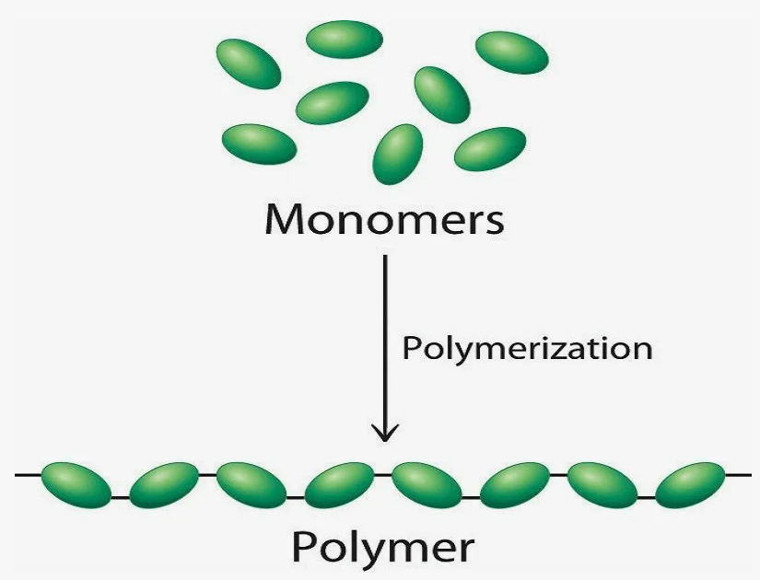

Slide 5
Types of polymers

Slide 6
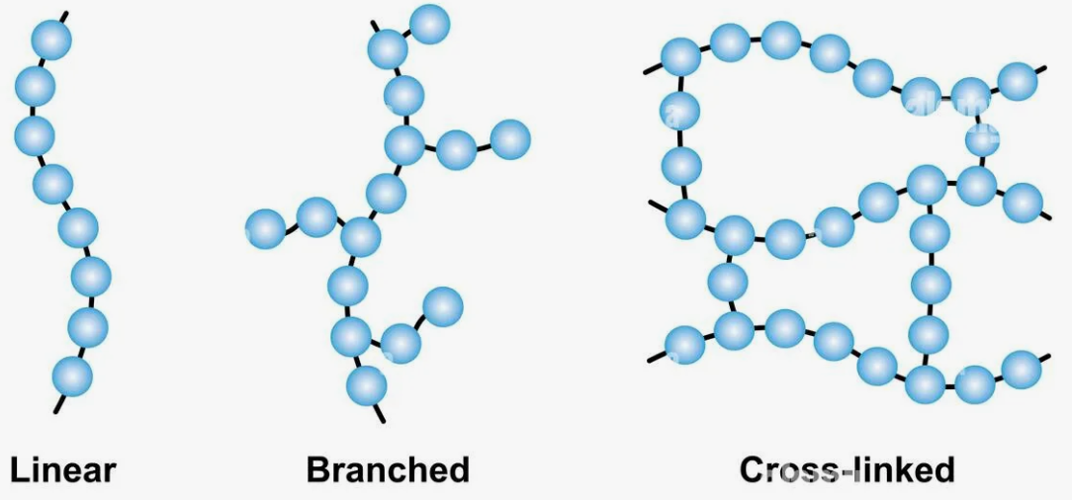

Slide 7
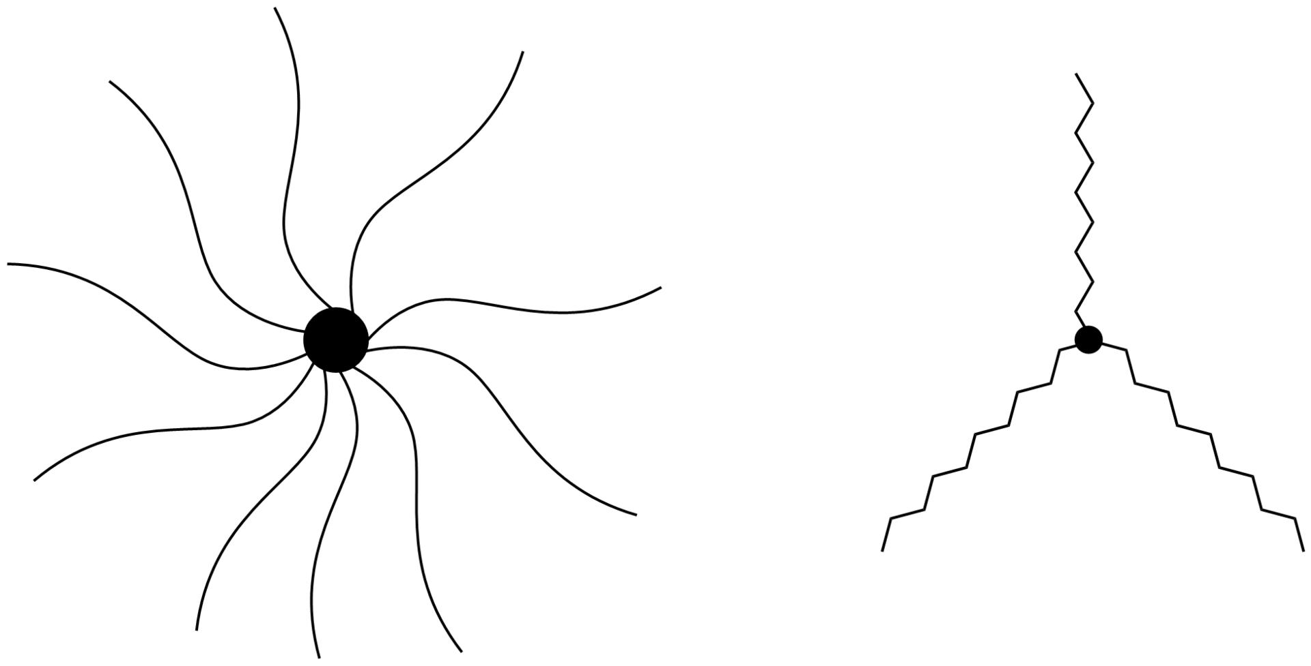
Star-shaped polymers

Slide 8
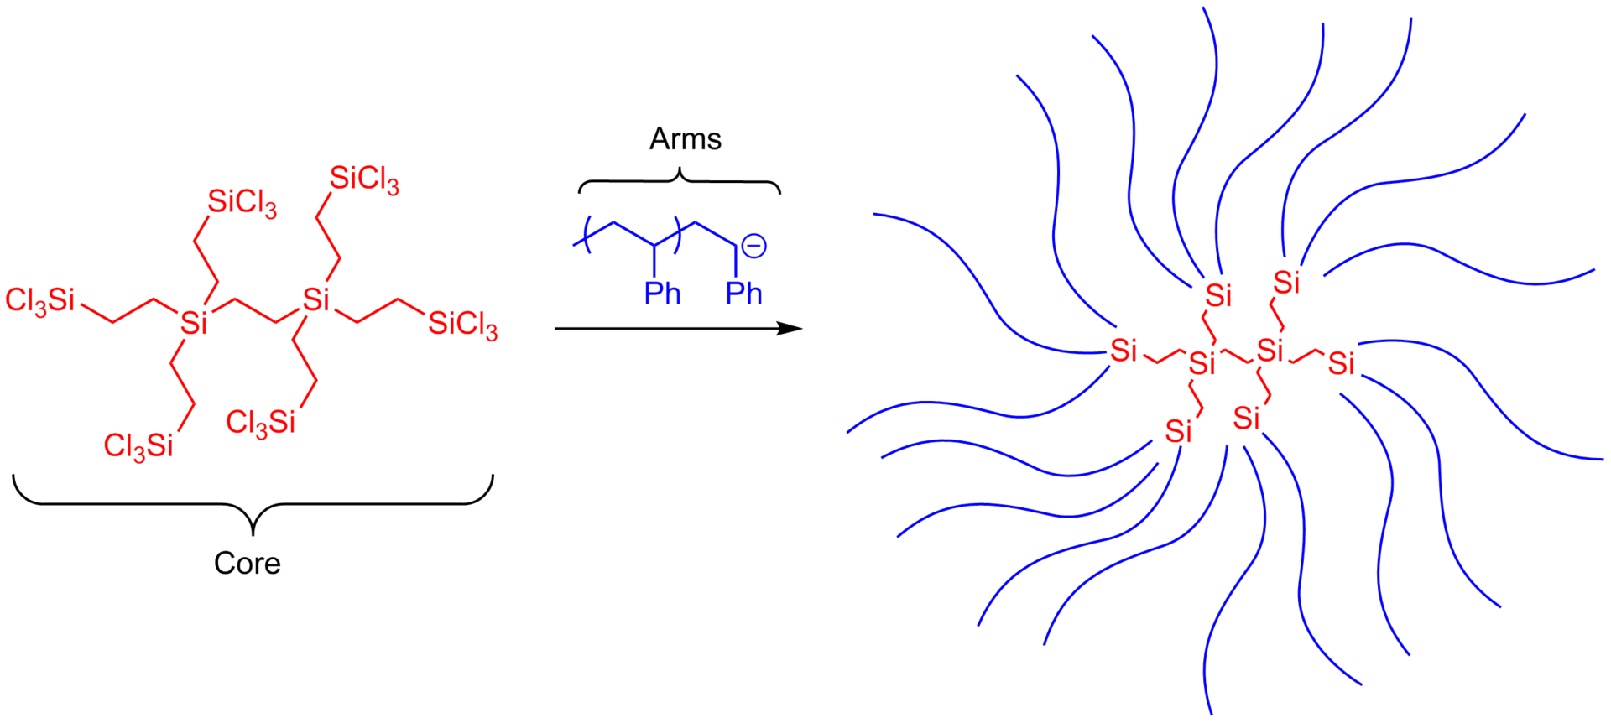
Arm-first synthesis using a chlorosilane derivative core and anionic monomer arms

Slide 9
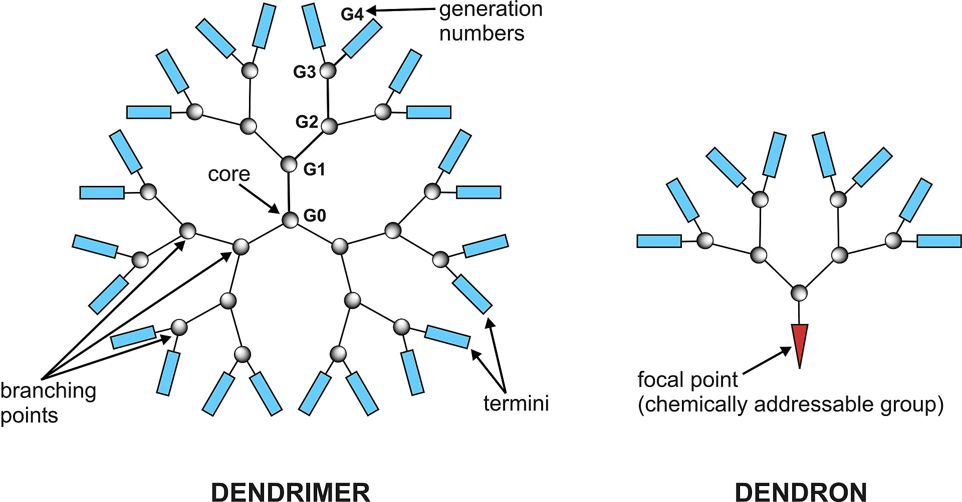

Slide 10
Application of polymers

Slide 11
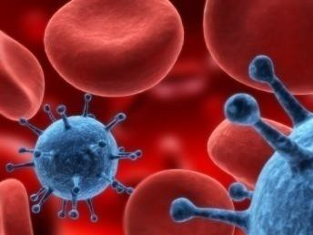
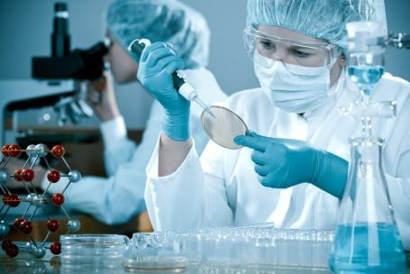

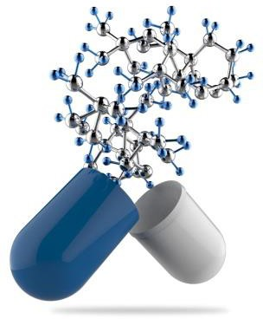

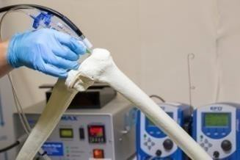





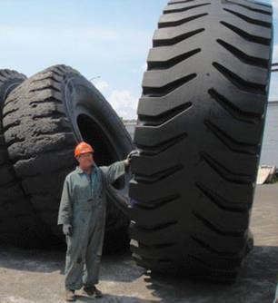

Medicine
Industry

Slide 12
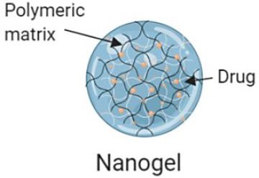
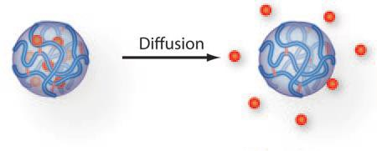
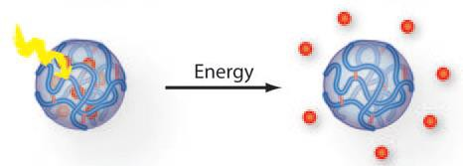
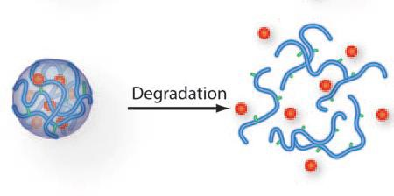
Hydrogels as drug delivery system

Slide 13
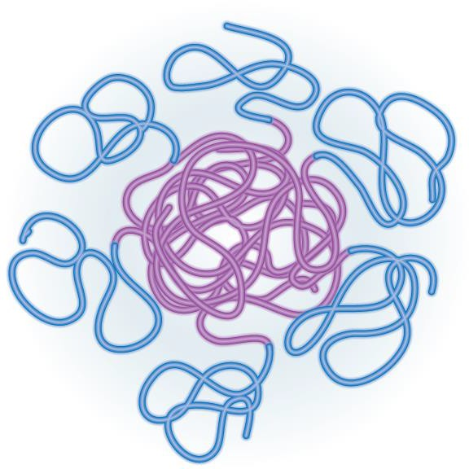


Micelles as drug delivery system
Hydrophilic crown
Hydrophilic part
CMC
Hydrophobic nucleus
Hydrophobic part

Slide 14
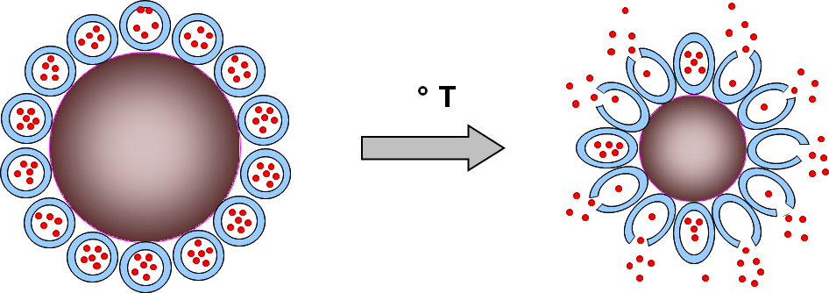


Smart polymers

Slide 15


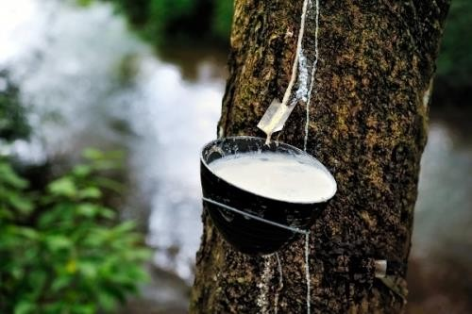
Latexes

Slide 16
Introduction into polymer synthesis

Slide 17
Step-growth and chain-growth polymerization
In polymer chemistry, step-growth polymerization refers to a type of polymerization mechanism in which bi-functional or multifunctional monomers react to form first dimers, then trimers, longer oligomers and eventually long chain polymers.
Chain-growth polymerization or chain-growth polymerisation is a polymerization technique where monomer molecules add onto the active site on a growing polymer chain one at a time

Slide 18
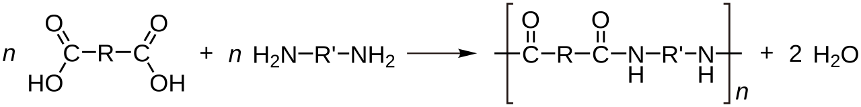
Polycondensation
a Condensation reaction is a type of chemical reaction in which two molecules are combined to form a single molecule, usually with the loss of a small molecule such as water.
Condensation polymers are any kind of polymers whose process of polymerization involves a condensation reaction (i.e. a small molecule, such as water or methanol, is produced as a byproduct).
Condensation polymers are formed by polycondensation, when the polymer is formed by condensation reactions between species of all degrees of polymerization.
Linear polymers are produced from bifunctional monomers, i.e. compounds with two reactive end-groups.
Condensation polymerization is a form of step-growth polymerization

Slide 19
Step-growth and chain-growth polymerization
In polymer chemistry, step-growth polymerization refers to a type of polymerization mechanism in which bi-functional or multifunctional monomers react to form first dimers, then trimers, longer oligomers and eventually long chain polymers.
Chain-growth polymerization (AE) or chain-growth polymerisation (BE) is a polymerization technique where monomer molecules add onto the active site on a growing polymer chain one at a time

Slide 20
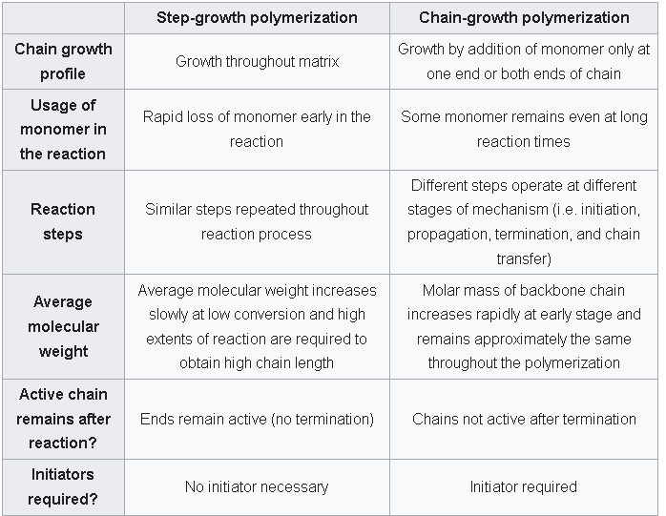
Step-growth and chain-growth polymerization

Slide 21
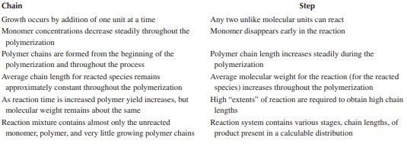
Step-growth and chain-growth polymerization

Slide 22
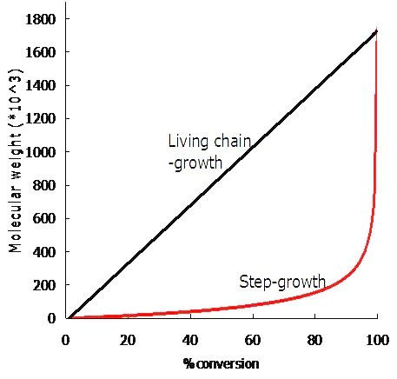

Slide 23

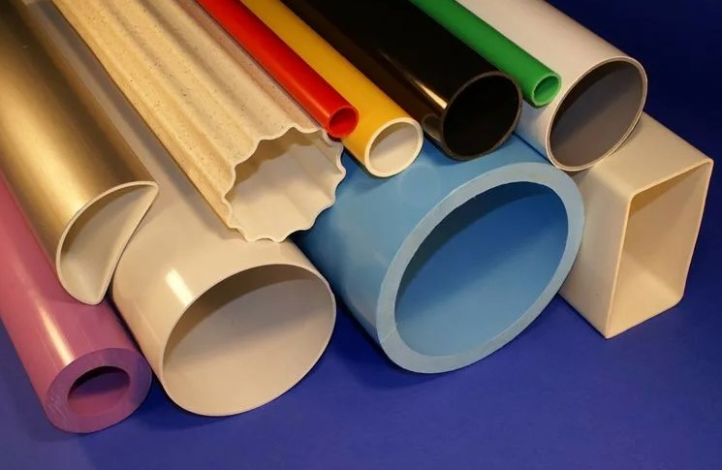
Chain growth. Polymerization. Polyvinylchloride synthesis

Slide 24


Step growth. Polycondensation. Polyesters synthesis

Slide 25

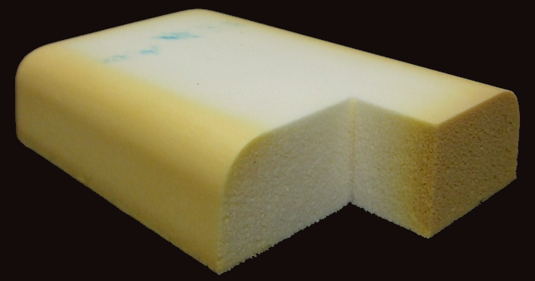
Step growth. Migration polymerization. Polyurethanes synthesis

Slide 26
Ecological problems of polymers

Slide 27
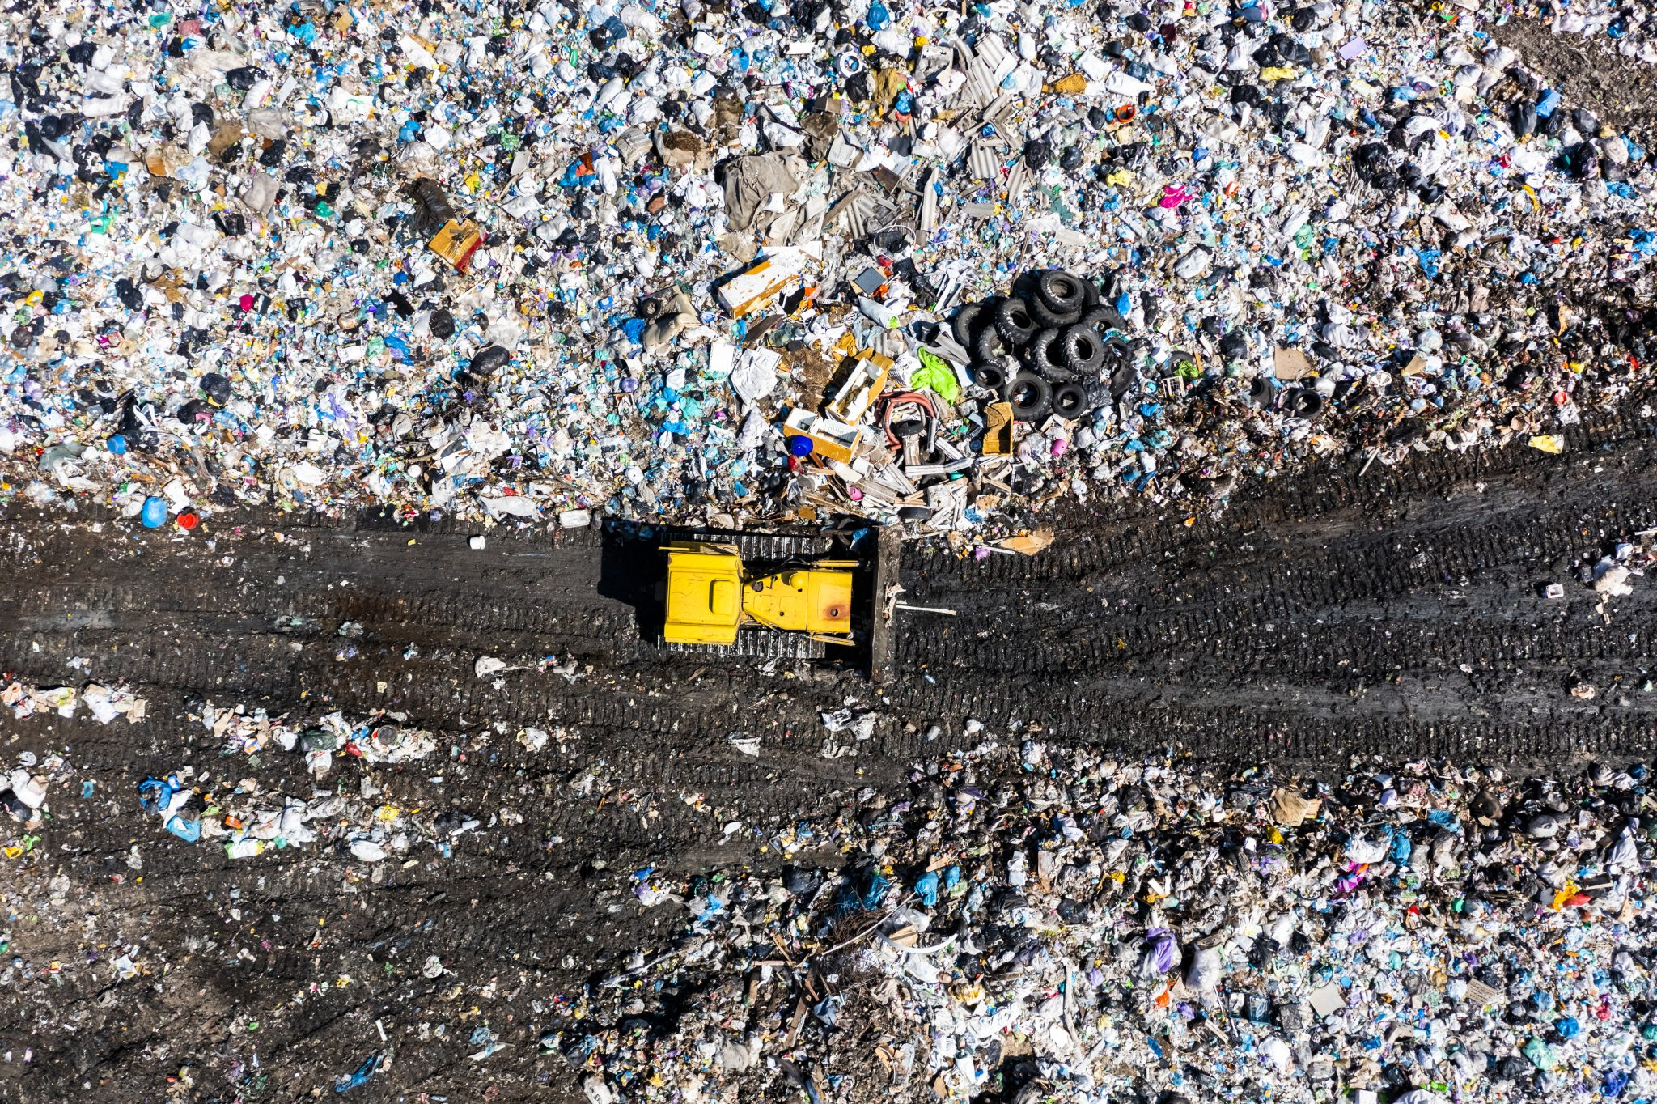
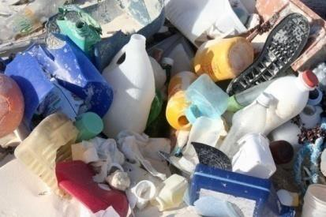
Polymer pollution

Slide 28
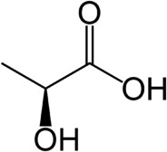
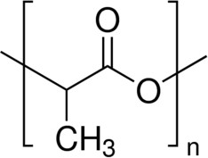
Lactic acid and polylactide

