Slide 1

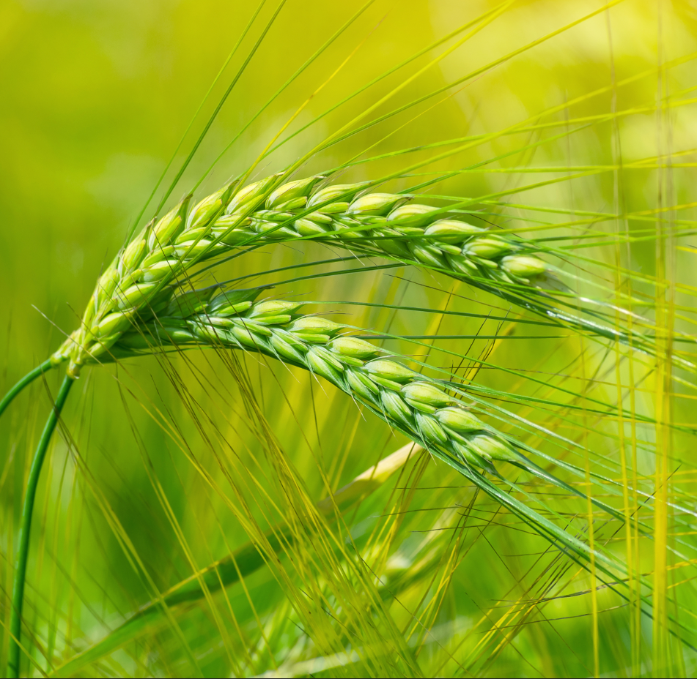
Possible Policies and Actions to Protect the Soil Cultural and Natural Heritage
Edoardo A.C. Costantini
President - International Union of Soil Sciences

Slide 2
The IUSS
The International Union of Soil Sciences (IUSS) is the global union of soil scientists.
The objectives of the IUSS are to promote all branches of soil science, and to support all soil scientists across the world in the pursuit of their activities.
The IUSS aims to promote the recognition of soil as a vital resource, in need of sustainable management and conservation.
The IUSS is a free and autonomous organization, financed primarily by member contributions, providing a reputation for soil scientists and a collaborative space.
The IUSS is based on two pillars:
- it is a union of national societies or academies (the Full members)
- it is an organization of soil scientists (individual members).

Slide 3
The IUSS Full an Individual Members
The Full members of the IUSS are 79 National Soil Science Societies or Academia.
The estimated Individual members (through the National Soil Science Societies) is about 50,000
The IUSS holds relationships with 8 regional societies:
- African Soil Science Society (ASSS)
- East and Southeast Asia Federation of Soil Science Societies (ESAFS)
- European Confederation of Soil Science Societies (ECSSS)
- Federation of Eurasian Soil Science Societies (FESSS)
- Latin American Soil Science Society (SLCS)
- Soil Science Society of East Africa (SSSEA)
- Pacific Regional Society of Soil Science (PRSSS)
- Central Asian Soil Science Society (CASSS)

Slide 4
The IUSS Structure
Governance: the Council, the Executive and President's Committees, the Secretariat, responsible for management.
Science: 4 Divisions, 21 Commissions, 17 WGs, and the Forum
Division 1 – Soils in Space and Time
C1.1 Soil morphology and micromorphology
C1.2 Soil geography
C1.3 Soil genesis
C1.4 Soil classification
C1.5 Pedometrics
C1.6 Paleopedology
Division 2 – Soil Properties and Processes
C2.1 Soil physics
C2.2 Soil chemistry
C2.3 Soil biology
C2.4 Soil mineralogy
C2.5 Soil chemical, physical and biological interfacial reactions

Slide 5
The IUSS Structure
Division 3 – Soil Use and Management
C3.1 Soil evaluation and land use planning
C3.2 Soil and water conservation
C3.3 Soil fertility and plant nutrition
C3.4 Soil engineering and technology
C3.5 Soil degradation control, remediation, and reclamation
C3.6 Salt-affected soils
Division 4 – The Role of Soils in Sustaining Society and the Environment
C4.1 Soil and the environment
C4.2 Soil, food security, and human health
C4.3 Soil and land use change
C4.4 Soil education and public awareness
C4.5 History, philosophy, and sociology of soil science

Slide 6
The IUSS WGs
Division 1
Cryosols
Digital Soil Mapping
Digital Soil Morphometrics
Global Soil Map
Proximal Soil Sensing
Soil Information Standards
Soil Monitoring
Universal Soil Classification
World Reference Base
Division 2
Hydropedology
International Soil Modeling Consortium
Division 3
Acid Sulphate Soils
Forest Soils
Paddy Soils
Soils of Urban, Industrial, Traffic, Mining and Military Areas (SUITMA)
Division 4
Cultural Patterns of Soil Understanding
Young and Early Career Scientists

Slide 7
The IUSS main outputs
WCSS every 4 years + 1 inter-congress + special congress: Centennial
Every year:
- 40-80 main scientific events organized by Divisions, Commissions and WGs
- Over 2000 events organized for the World Soil Day on the 5th of December every year, in collaboration with the FAO
- 2 Bulletin and 12 Alert
- 1-2 Books, also open source
Awards and prizes:
- the Dokuchaev and Von Liebig Award, for basic and applied researches
- the Jeju Award for young and mid-career soil scientist
- the IUSS Distinguished Service Medal, for outstanding world soil leaders who have translated soil science into action;
Honorary members
Promotion of individual member by other scientific organization, such as the ISC
IUSS Stimulus Fund and projects

Slide 8
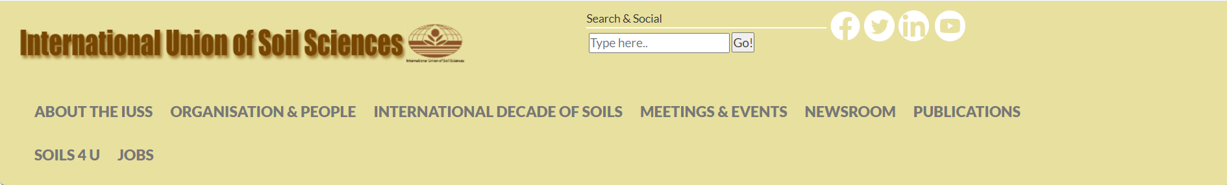
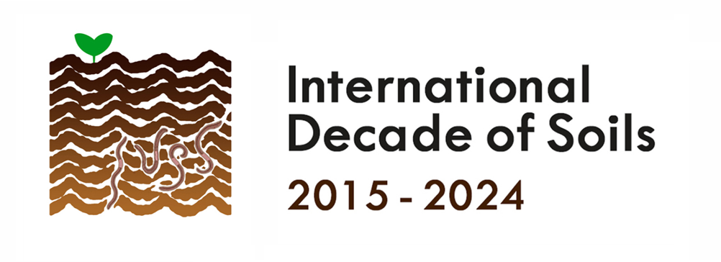
The IUSS Website and Social Media
https://www.iuss.org/
  Facebook www.facebook.com
  LinkedIn www.linkedin.com
  Youtube www.youtube.com
  Twitter www.twitter.com

Slide 9
The IUSS 2021-2030 Strategic Plan
Our strategic goals
Improvement of soil consciousness.
Increasing participation of the IUSS members.
Raising stakeholder engagement and strengthened linkages with international scientific organizations.
Fostering scientific publications with higher impact.
Boosting communication of scientific results, promoting public understanding, recognition, esteem, and engagement in soil science.
Enhancing education, awareness and outreach at all levels.
Supporting awards, prizes, and medals.
Improved allocation and evaluation of economic resources.
Adoption of an equality and equity policy and their internal practice.

Slide 10
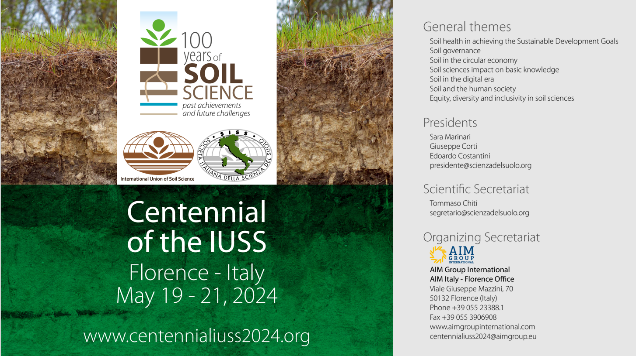

Slide 11
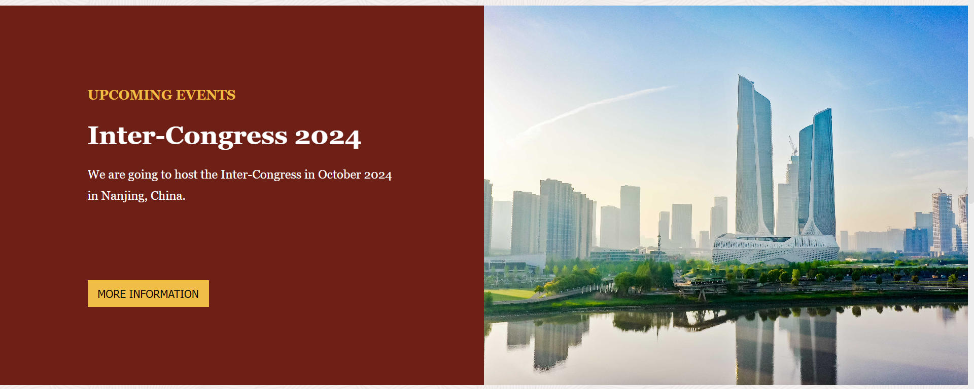
http://en.csss.org.cn/home

Slide 12
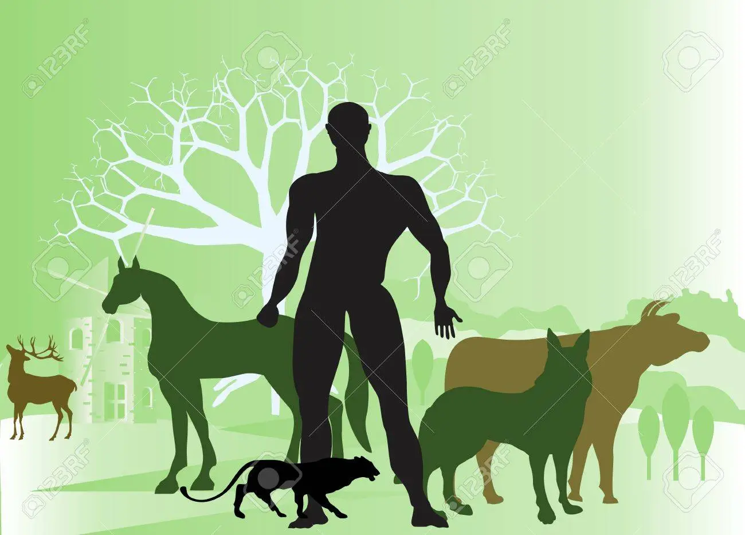
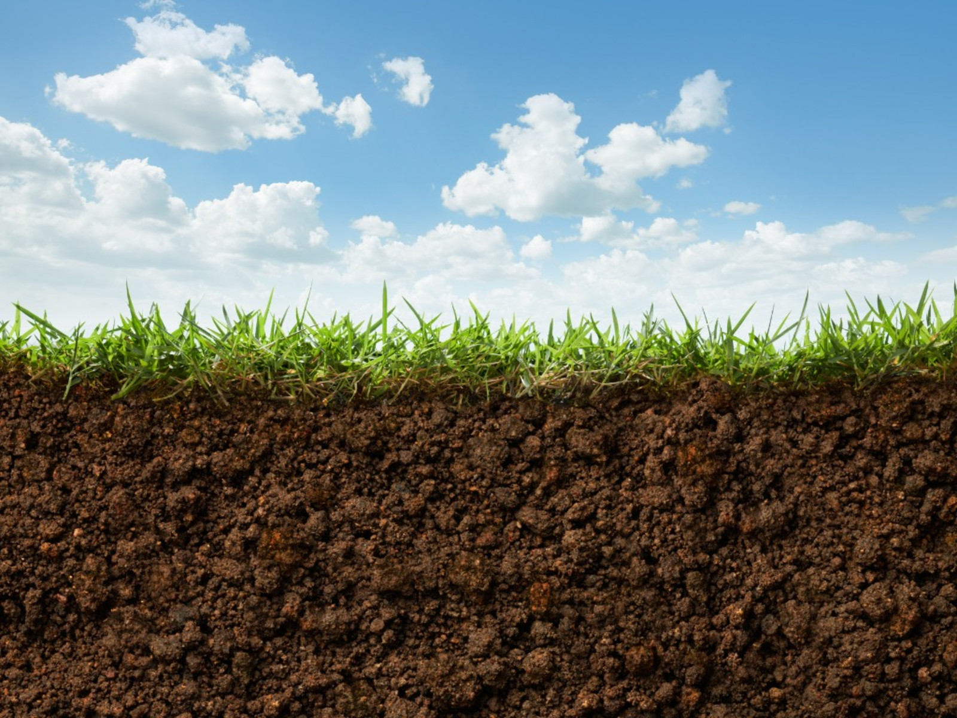
Strategic goal n°1: Improvement of soil awareness
Rights of man, animals, trees, nature…..
……are there soil rights?

Slide 13
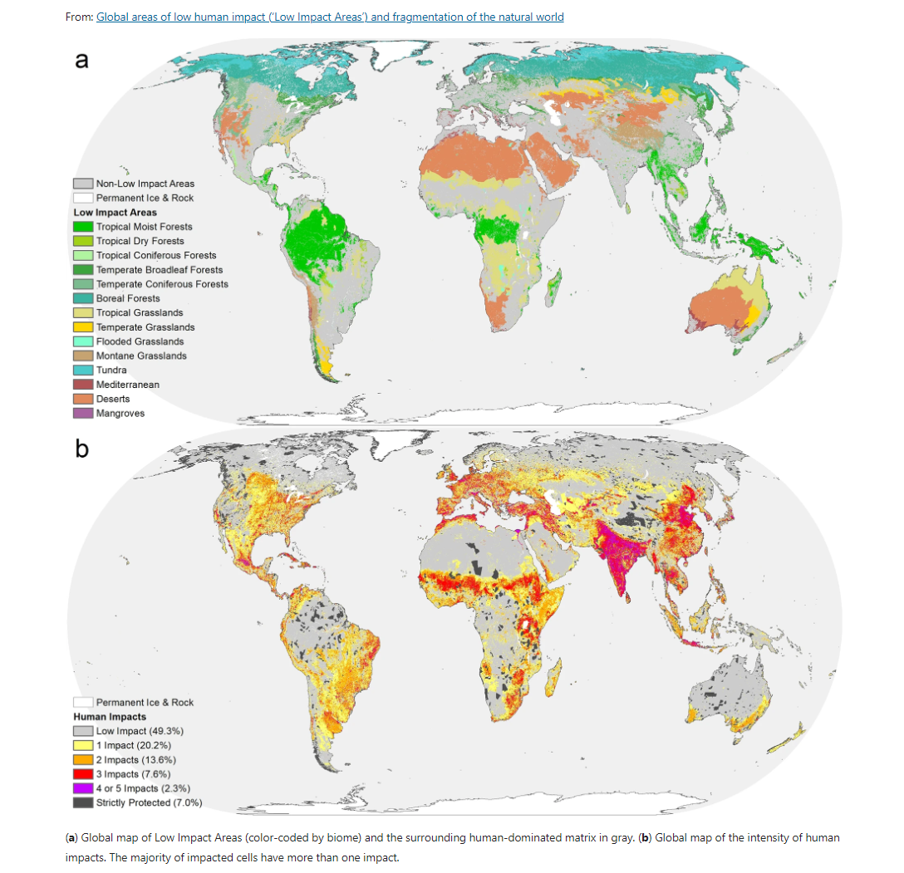
Low impact areas of the World are shrinking
Many natural soils are threatened with extinction!
Jacobson et al, 2019. Scientific Reports (Sci Rep) ISSN 2045-2322 (online)

Slide 14
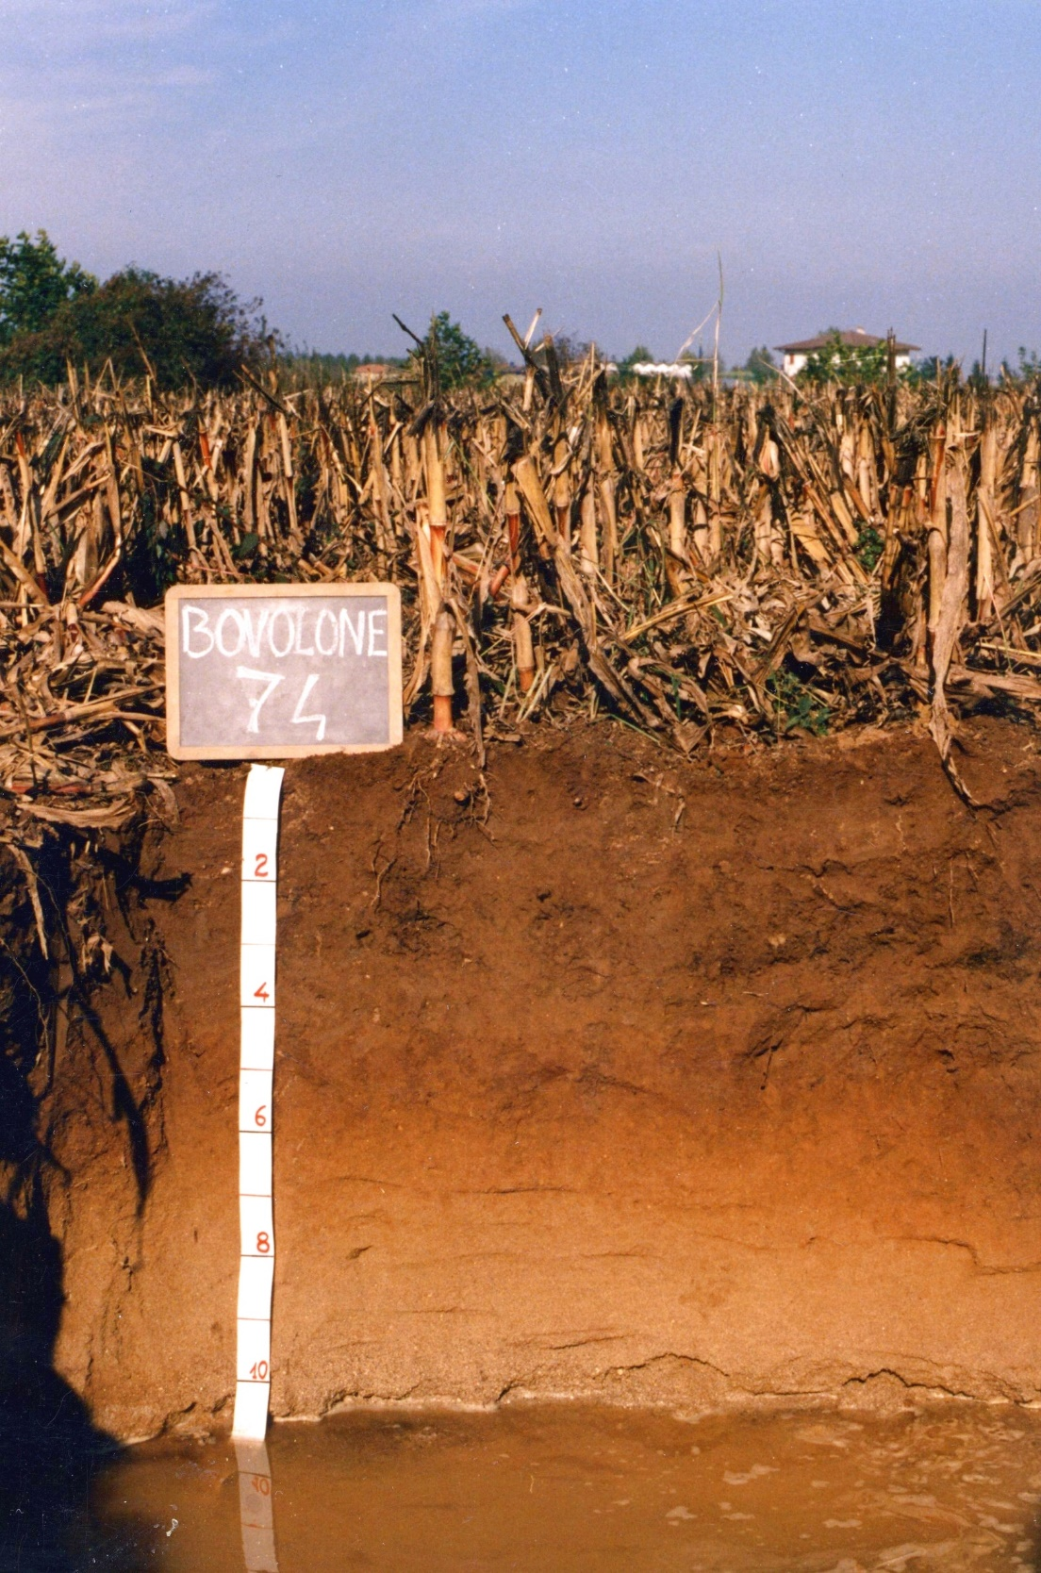
Focus on the ability to sustain life
Strategic goal n°1: Improvement of soil awareness
Focus on human needs
provide food and biomass;
absorb, store and filter water and transform nutrients and substances, thus protecting groundwater bodies;
provide the basis for life and biodiversity, including habitats, species and genes;
act as a carbon sink;
provide cultural services for humans and a physical platform and their activities;
act as a source of raw materials;
constitute an archive of the geological, geomorphological and archaeological heritage.
Soil health: the continued ability of soils to perform ecological functions for all forms of life
EU Soil Mission, 2020
EU Soil Strategy, 2021

Slide 15
Should we consider and respect the soil not only for its services, but in itself, as one of the manifestations of nature?
The soil as a natural body, capable of self-organization,
result of forming processes deriving from external and internal factors
Zanella A. et al., 2018

Slide 16
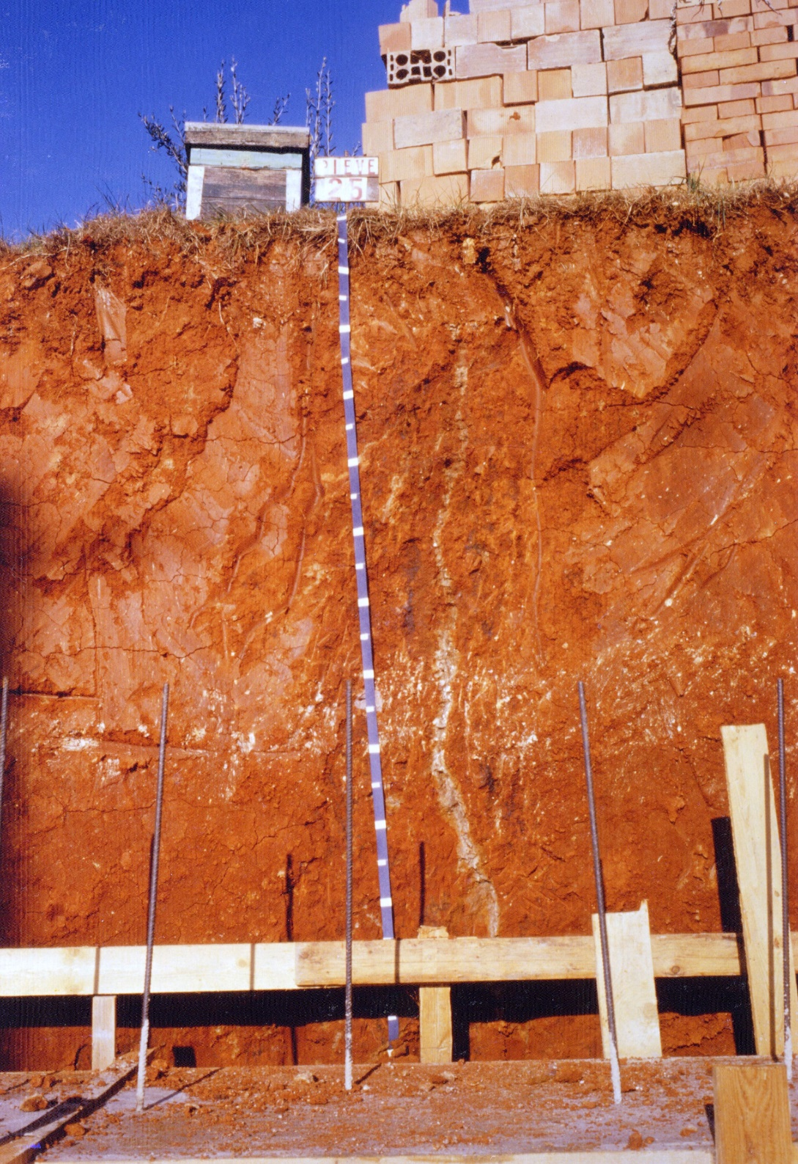
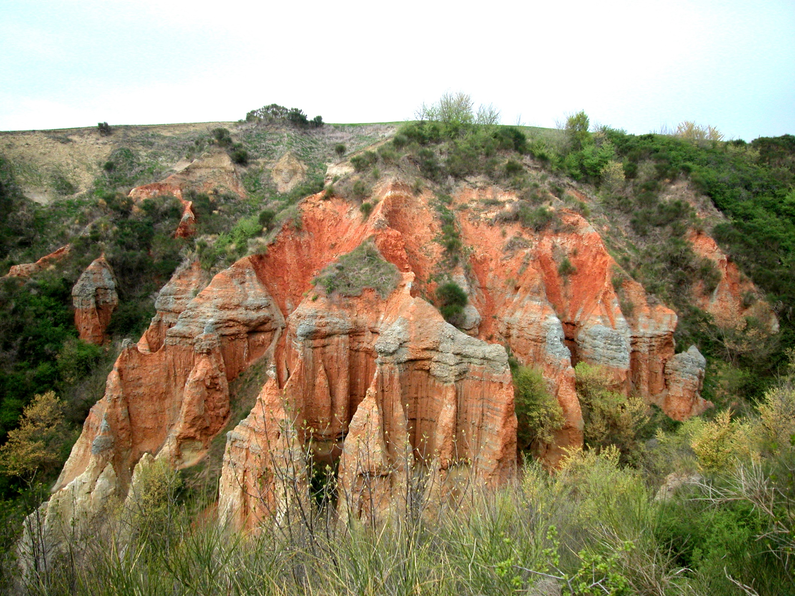
Should we protect soils with limited ecological services?
Or soils that can no longer stand current forms of life?

Slide 17
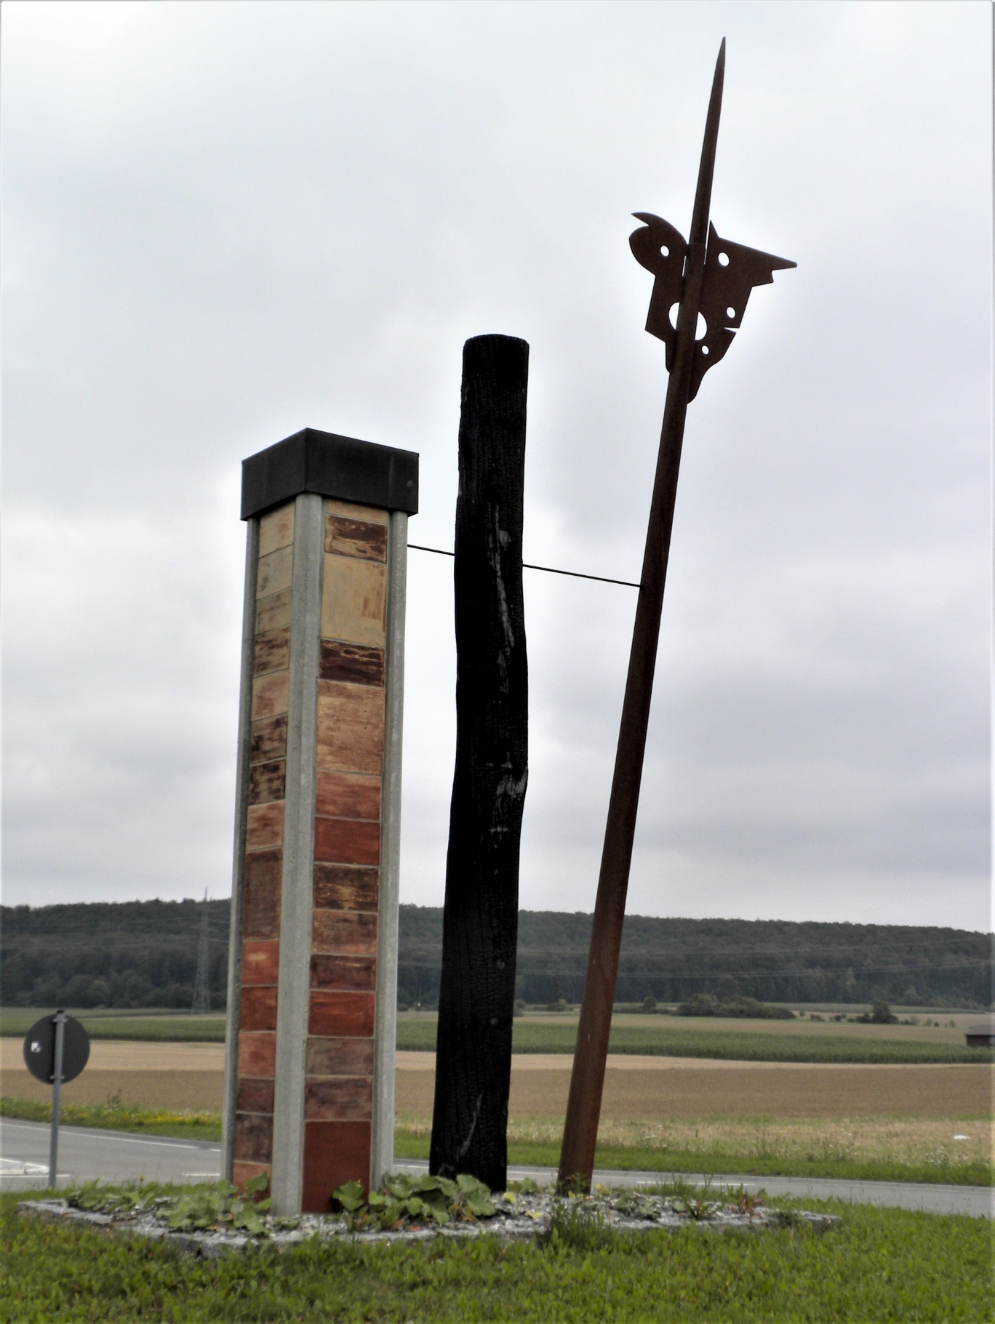
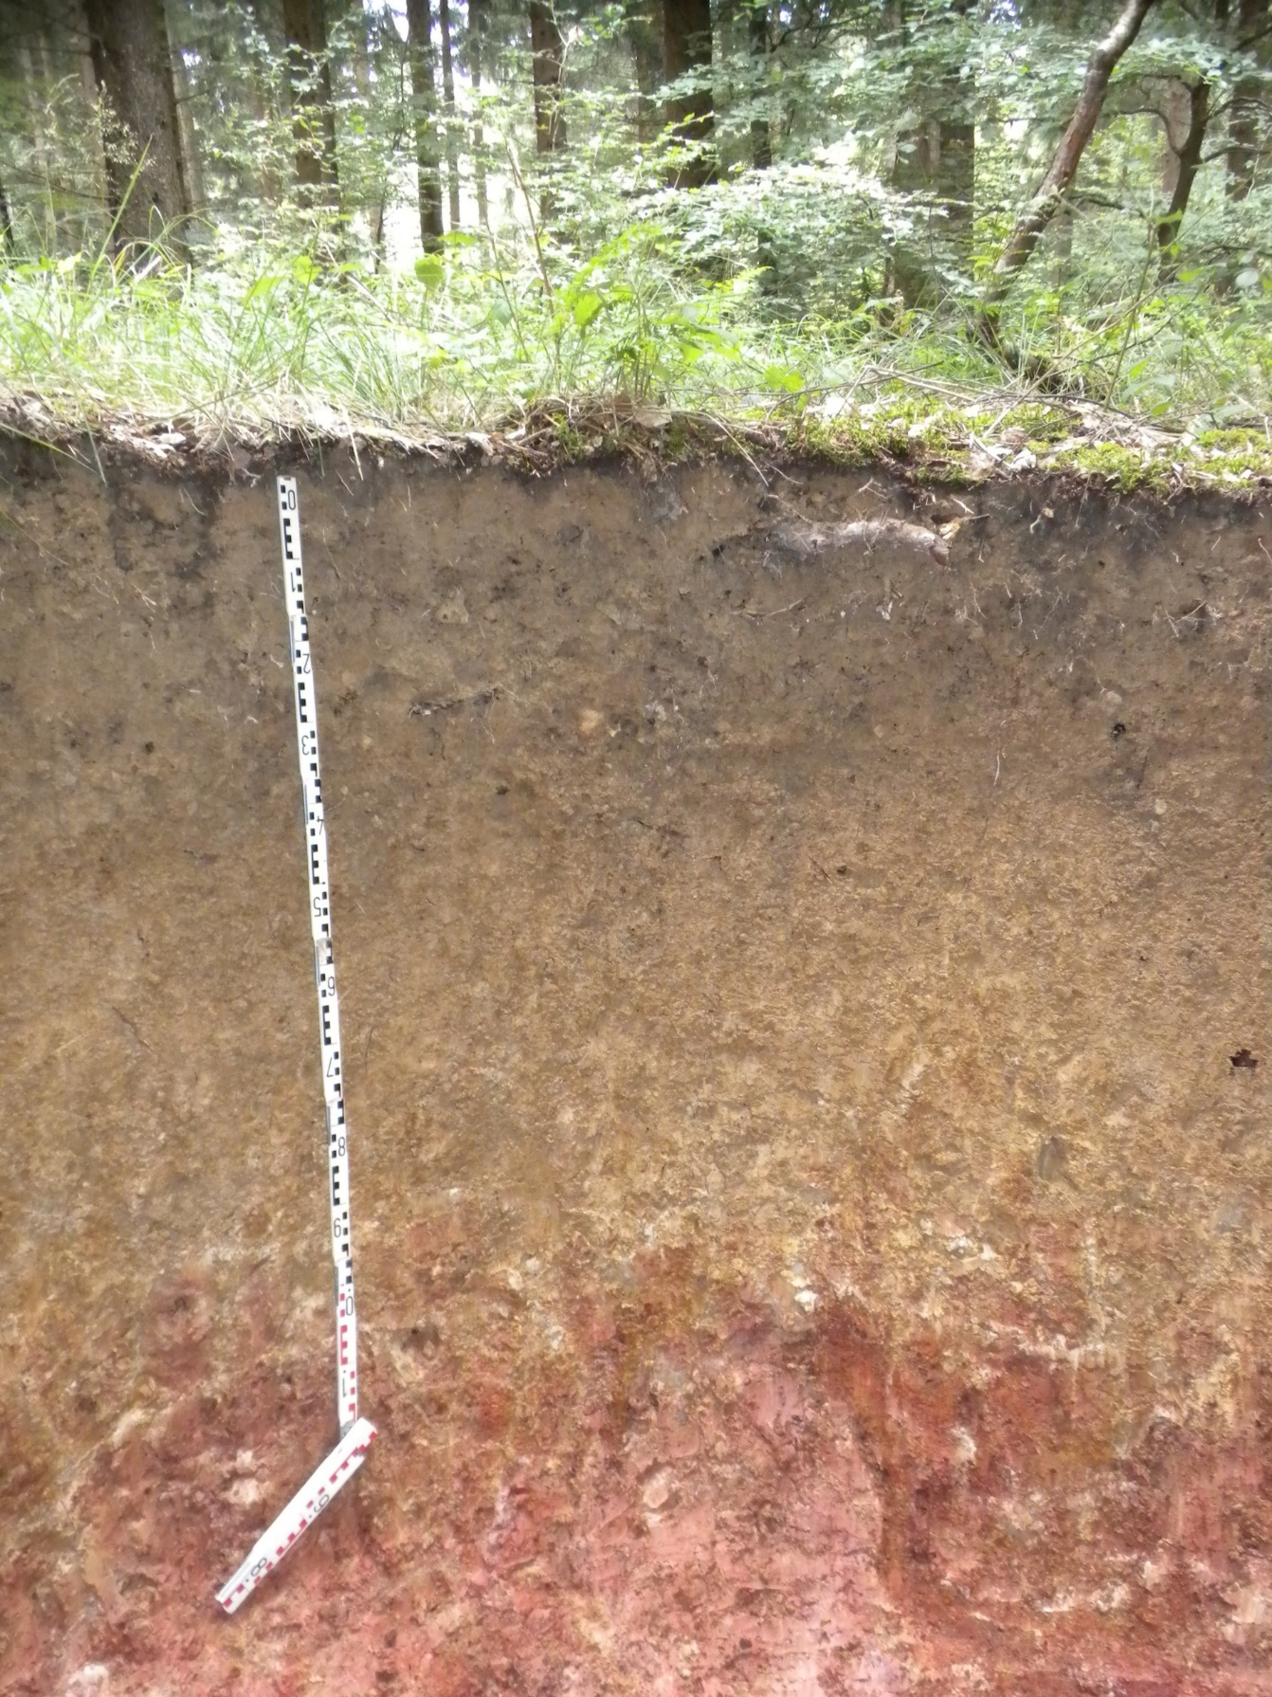
Should we protect soils that provide non-material values?

Slide 18
The 8 Criteria for highlighting the cultural and natural value of a pedosite (soil profile or pedolandscape)
scientific evidence of past environments, as provided by paleosols;
didactic interest, namely, soil classification, representing the main taxonomic units, the benchmarks of the main regional types, soils that exemplify rare natural or anthropogenic processes, pedological evolution models, including toposequences or ‘‘catenas’’;
archive of geological, geomorphological, paleontological, and archaeological heritage;
ecological value of soils in a delicate environmental balance, such as soils that contribute to the outliving of fragile ecosystems, relic situations, wildlife refuges, and biotopes;
historical and cultural interest, such as that of soils characterising a well-defined agricultural landscape, like soils of human terraced landscapes;
social and economic, for instance, when it is possible to attribute to a specific soil the production of excellence and peculiar food, such as the wine produced in an outstanding ‘‘terroir’’;
recreational, scenic and aesthetic values, including soils that contribute to the amenity of the landscape with their colours;
inspirational, religious, identity, ethnical and ethical relevance.
(Costantini, 2022)

Slide 19
Policies for the conservation of the cultural and natural heritage of soil
Global policies
World Heritage List, Biosphere Reserves, Geoparks of UNESCO
Sustainable Development Goals
FAO Sustainable Soil Management
European Soil Strategy
Research and innovation programs of Horizon Europe
Soil health and food mission
Soil literacy
National policies
Archaeological sites
Cultural landscapes
Rural landscapes
European Conventions
European landscape
Conservation of European Wildlife and Natural Habitats
Natura 2000

Slide 20
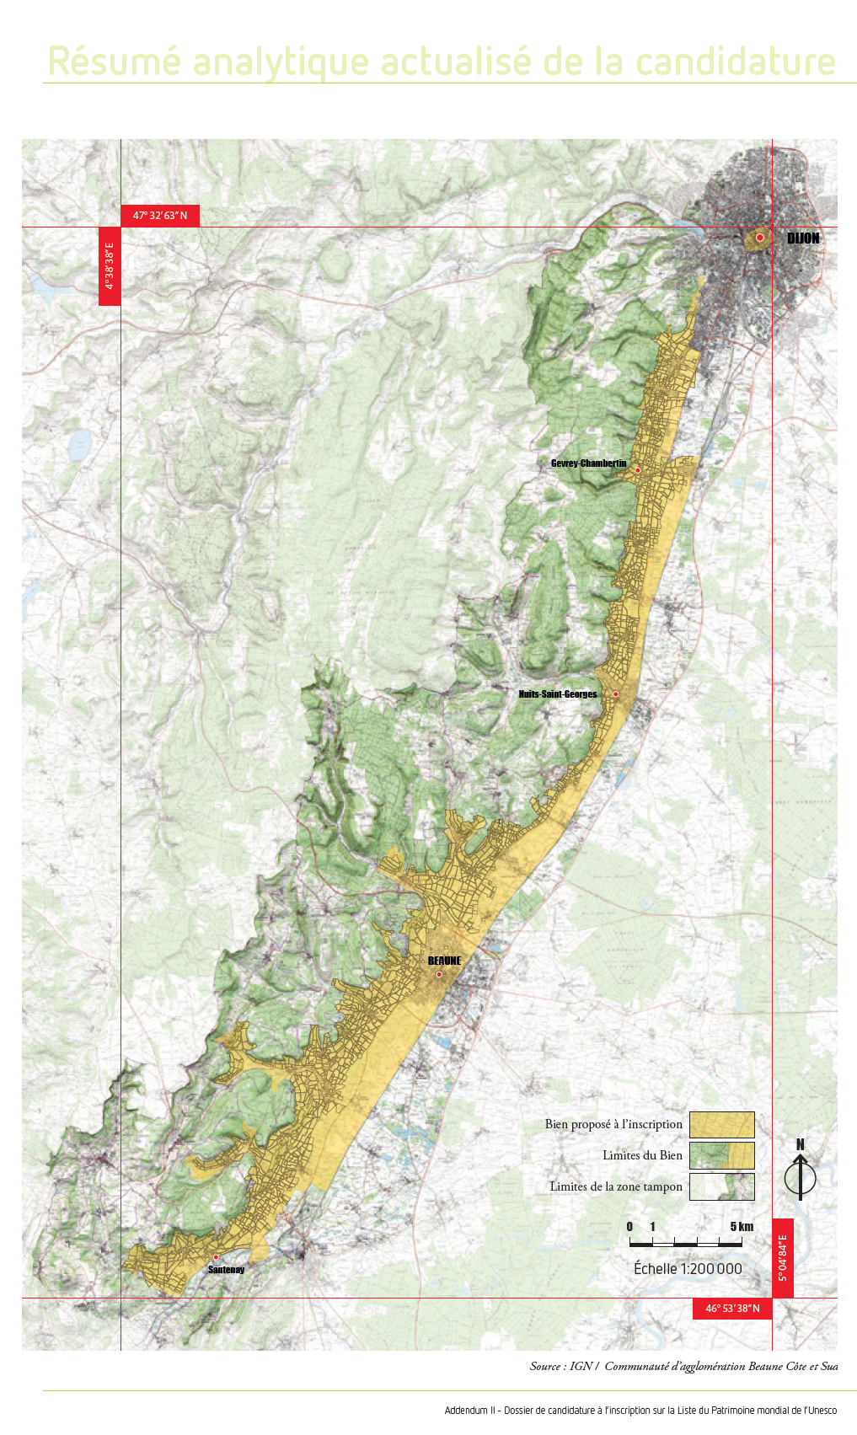
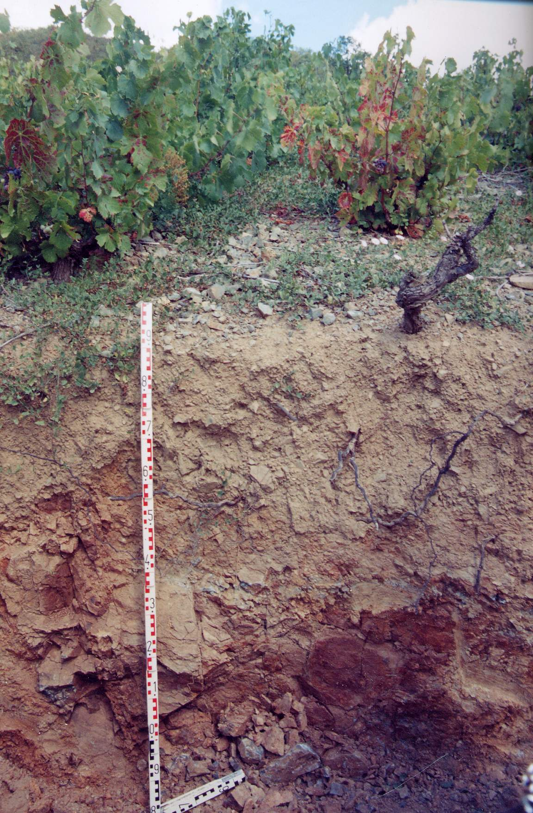
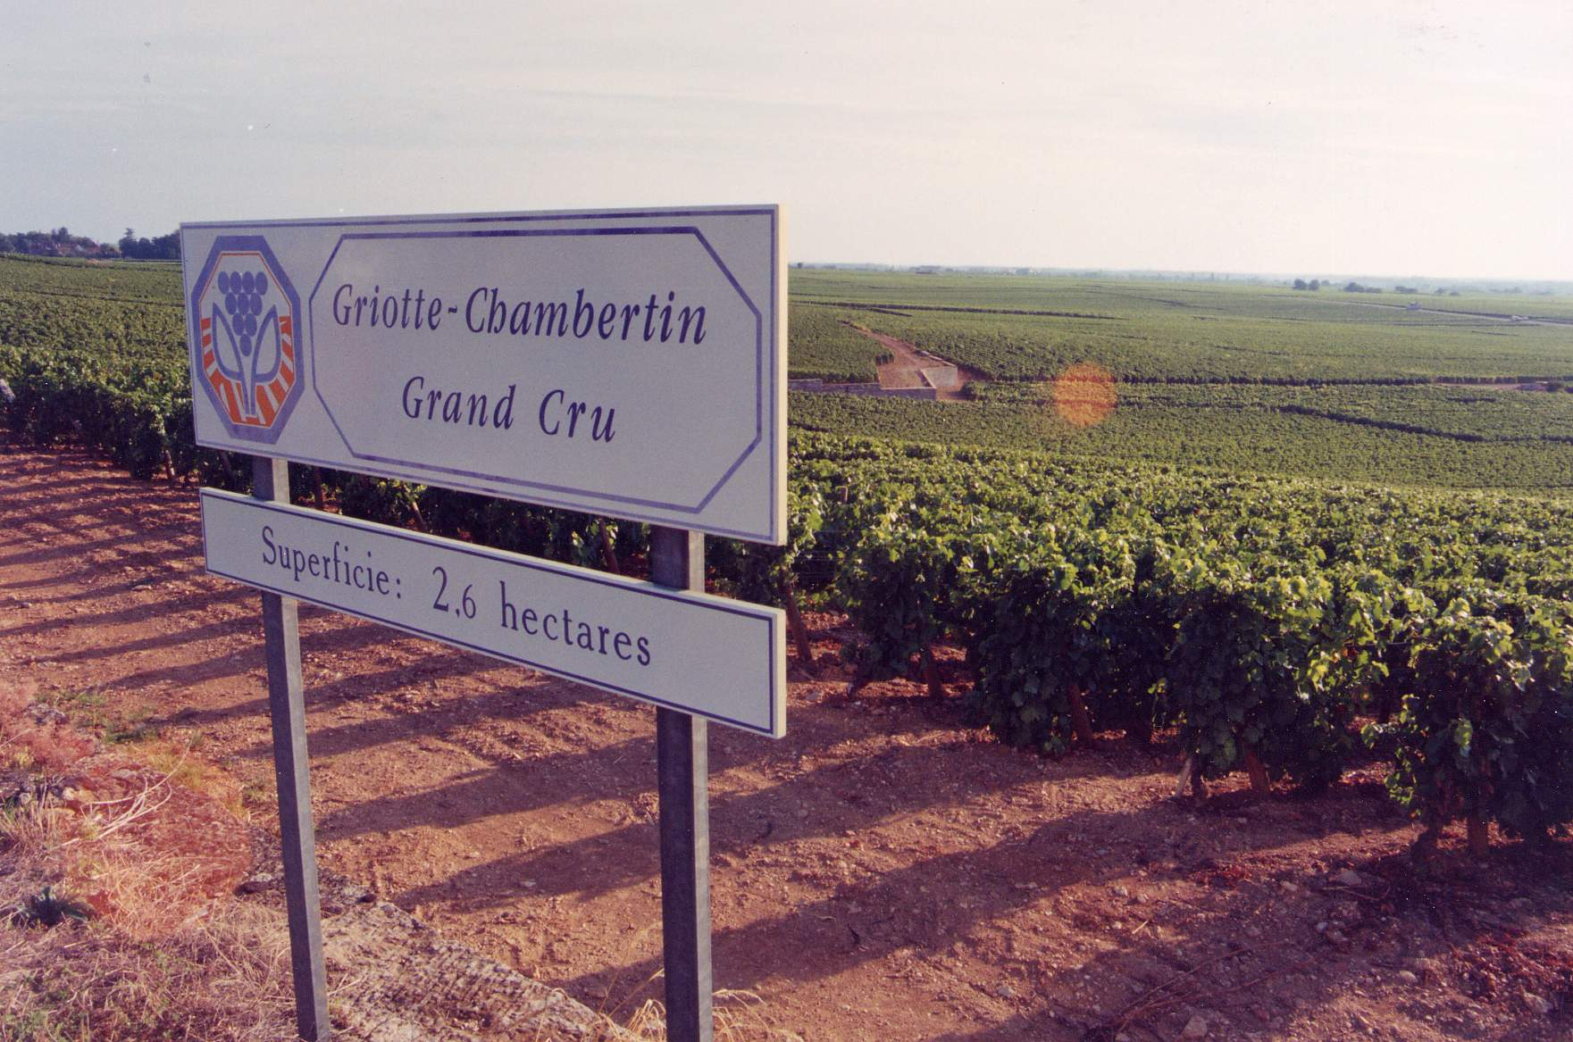
World Heritage Sites of UNESCO, The terroirs of Burgundy

Slide 21
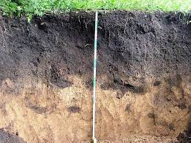
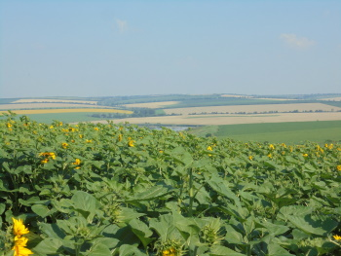
World Heritage Sites of UNESCO, tentative list
Typical Chernozems of the Balti Steppe in the Republic of Moldova

Slide 22
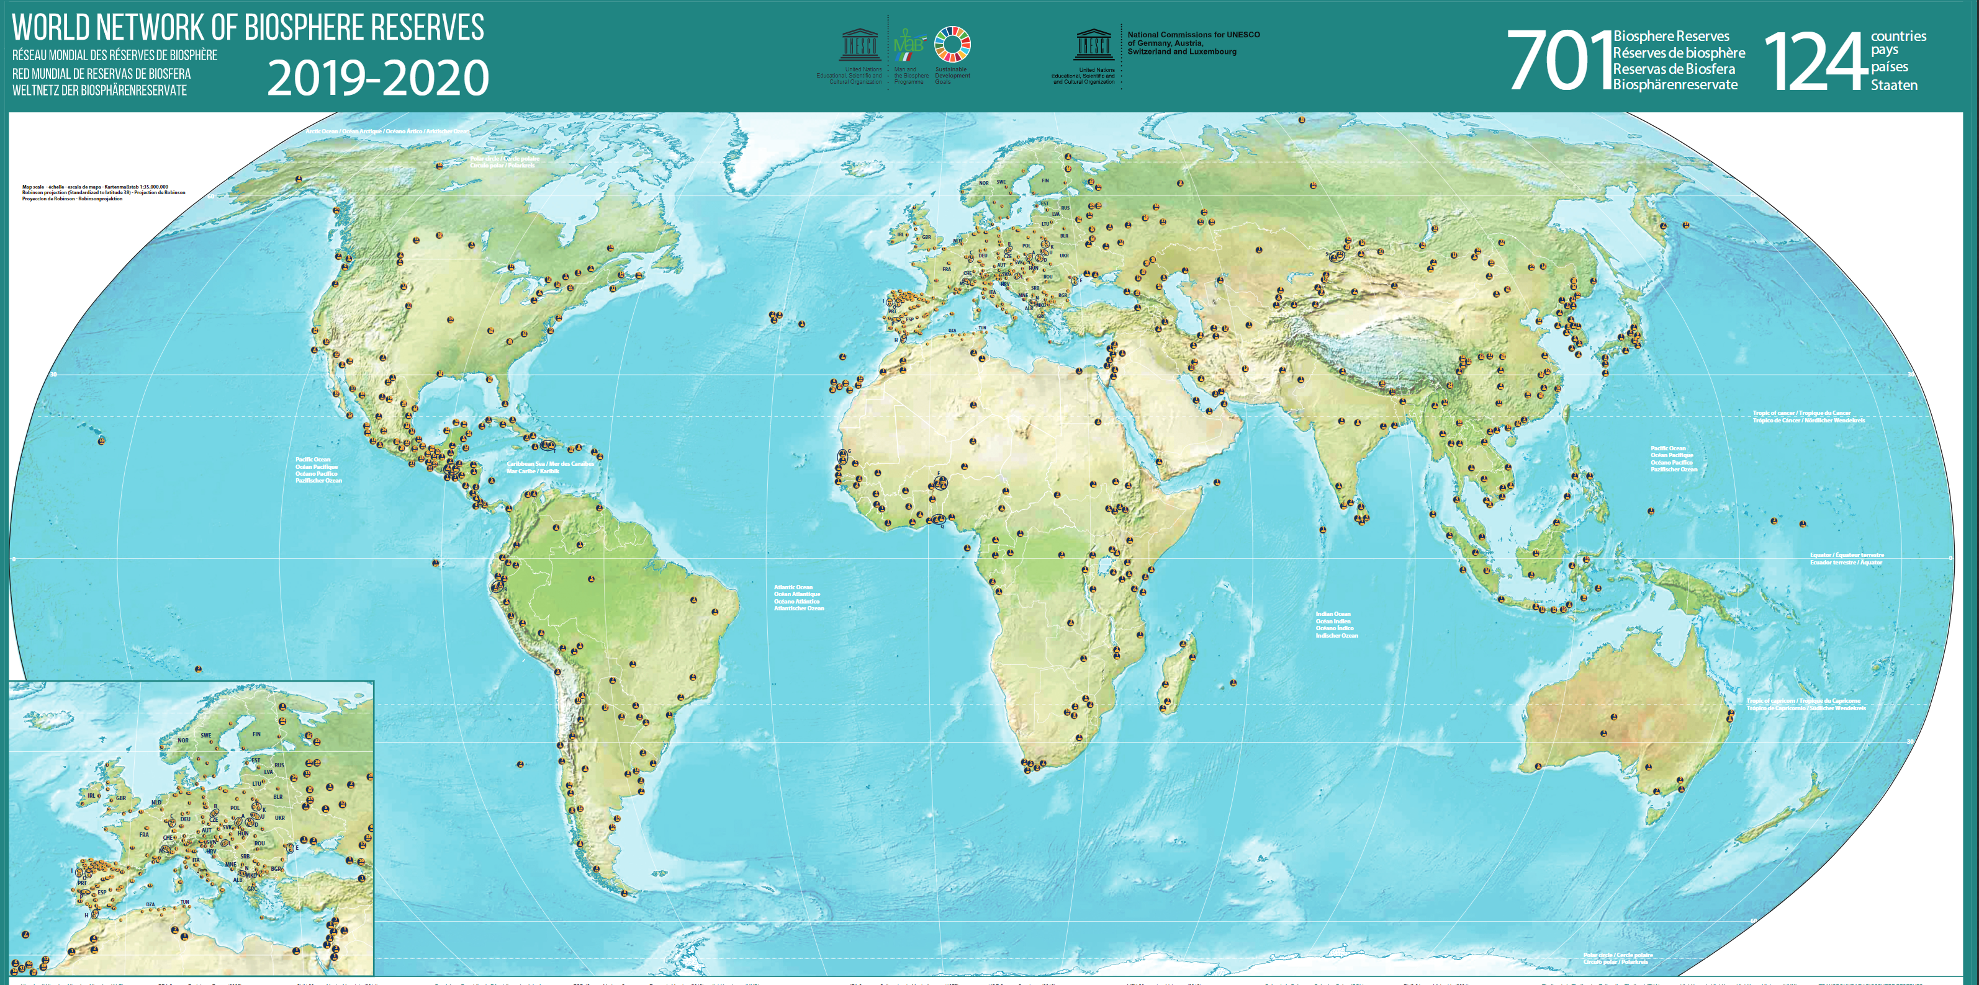
Biosphere Reserves (UNESCO)
The World Network of Biosphere Reserves covers all major representative natural and semi-natural ecosystems
It spans over a surface of more than 7,442,000 km² in 134 countries. It's almost the size of Australia.
They are under the sovereign jurisdiction of the states where they are located

Slide 23
Learning places for sustainable development
Ecosystem-specific networks
Ecosystem and theme-specific networks provide valuable insights into sustainable development models and climate change mitigation and adaptation possibilities. They include networks and research, capacity building and educational collaborations on:
Drylands
Mangroves
Marine, Coastal and Island Areas
Mountains
Savannahs
Tropical Forest
Wetlands
Designation and Review Process (unesco.org)

Slide 24
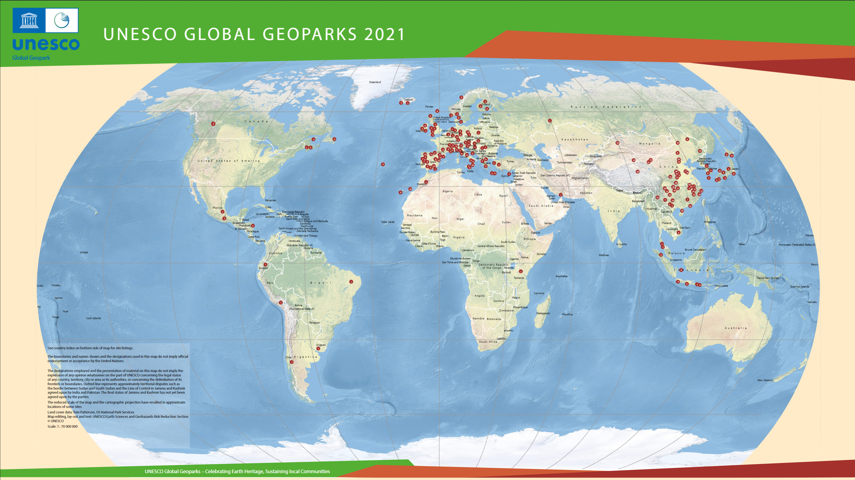
International Geoscience and Geoparks Programme (UNESCO) 195 geoparks in 48 countries

Slide 25
Sites and landscapes of international geological significance, managed for protection, education and sustainable development
Key point: visibility
Submit a UNESCO Global Geopark proposal | UNESCO

Slide 26
European policies: the objectives of the European Soil Mission
Reducing soil degradation linked to desertification
Conserving and increasing soil organic carbon stocks
No net soil sealing and increased urban land reuse
Reduce soil pollution and improve restoration
Prevent erosion
Improving soil structure
Reducing the EU's global soil footprint
Increasing soil literacy in society in all Member States: Have the basic tools needed to think about soils, soil processes and soil relevance in broader terms than merely utilitarian.

Slide 27
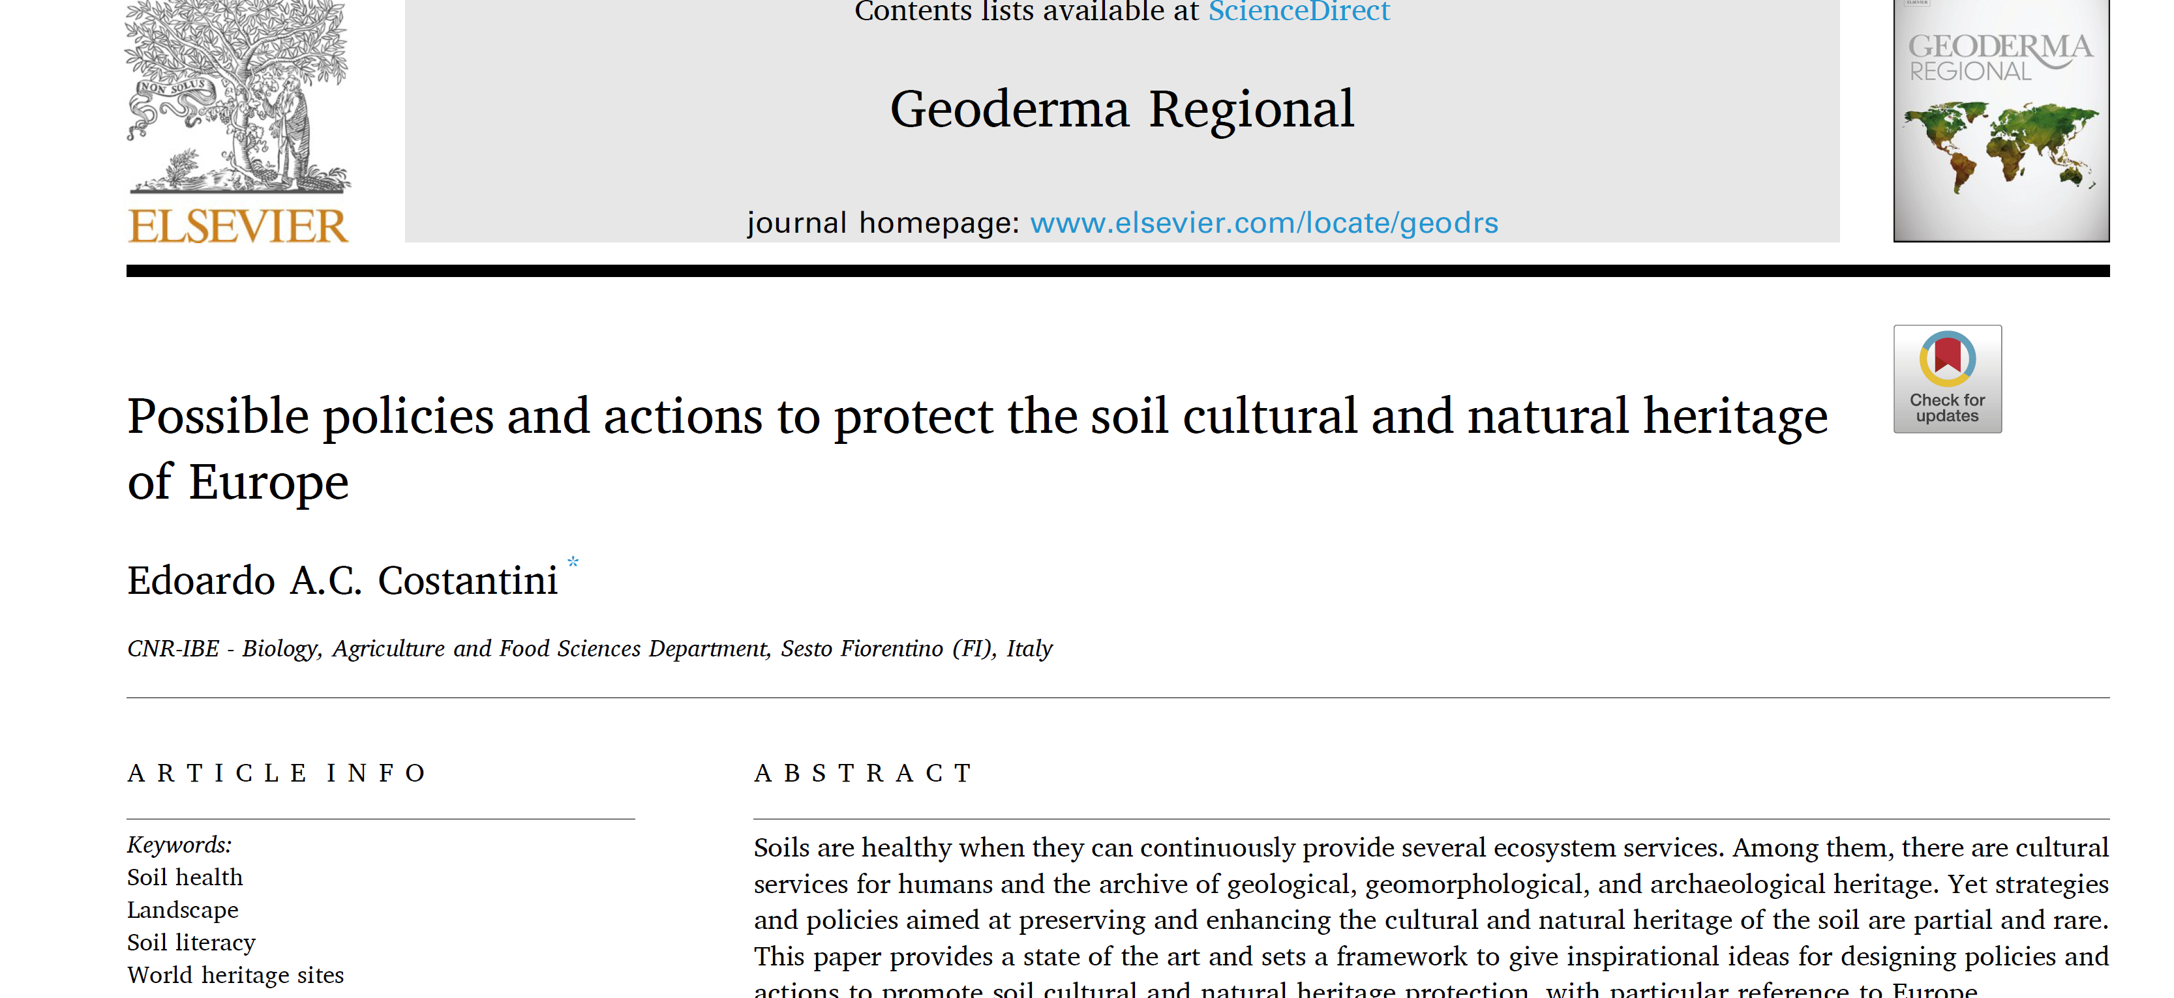
Conclusions
There are no specific actions for the protection of cultural and natural values of soil at European and international level
The importance of soil characteristics is reported in several cases present in the inventories of natural and cultural heritage
Making explicit the cultural and natural value of a soil improves soil awareness, soil literacy, and gives greater interest and motivation to the protection of the landscape
We must try to include soil cultural and natural values in policies already set up for the protection of the natural and rural landscape at global, European and national level.

Slide 28
Thank you!

