Slide 1
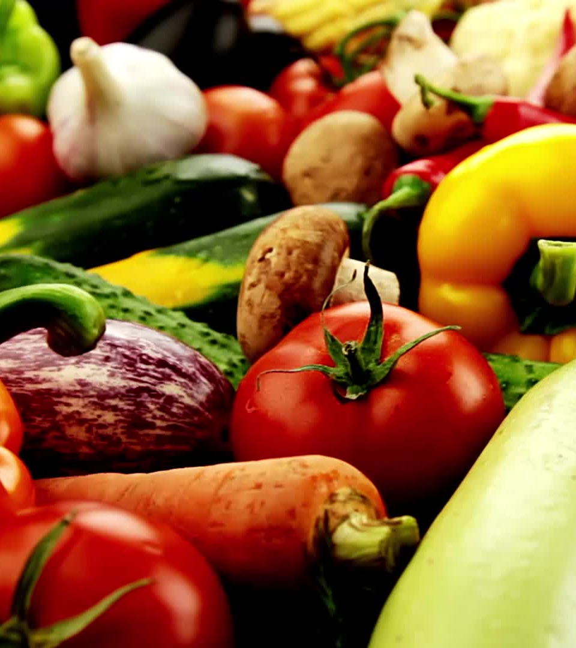
The Potential of African Resources in Promoting Global Food Security
An exploration of the role Africa can play in ensuring global food security
Lamsen Nkhata

Slide 2
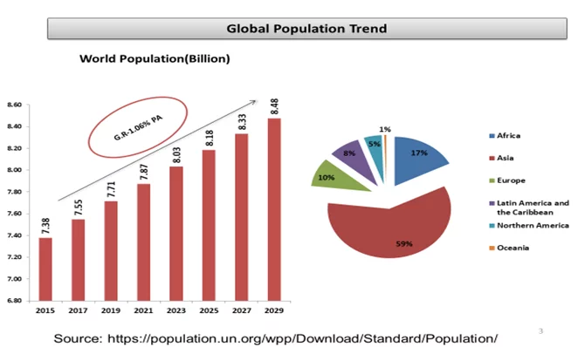
Global Population Trend
Text

Slide 3
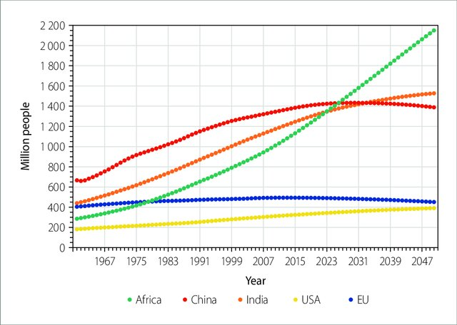
Global Population Trend
Text

Slide 4
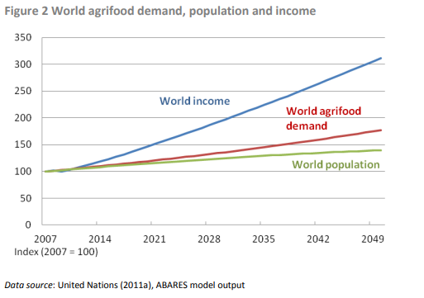
Global Food demands
Text

Slide 5
Overview of African Resources
Text
Overview of African Resources

Slide 6
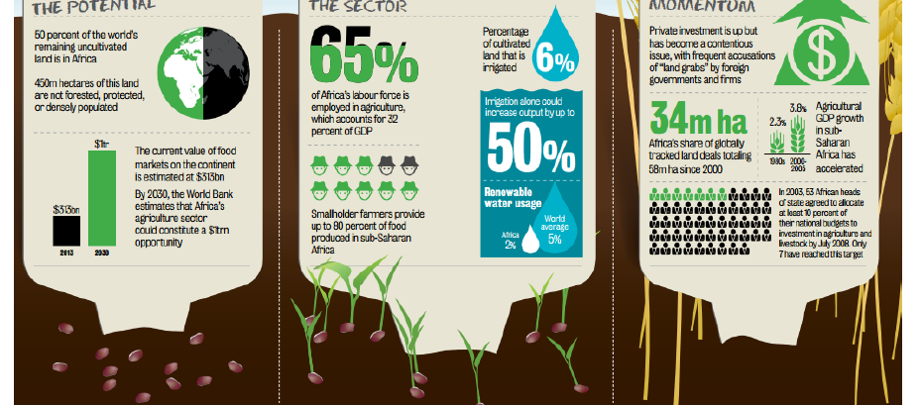
Agricultural Potential

Slide 7
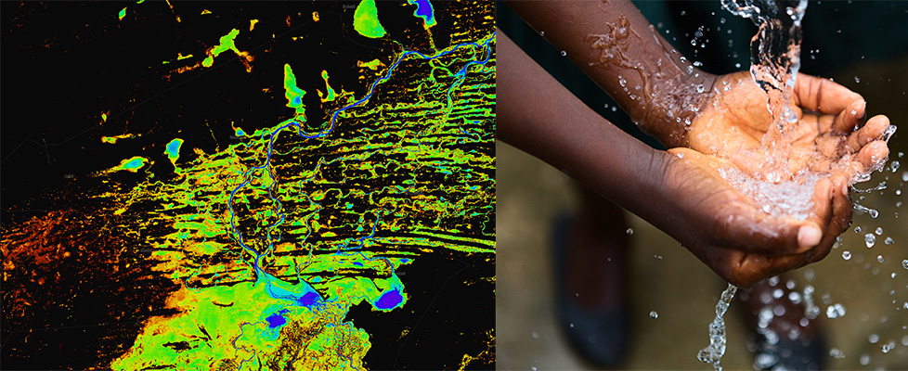
Water Resources

Slide 8
Water Resources cont..
Africa is endowed with abundant water resources, including rivers, lakes, and aquifers. Water plays a pivotal role in the continent's ecosystems and socio-economic development.
Sustainable water management strategies implemented in various African countries.
This include rainwater harvesting, watershed management, and efficient irrigation techniques.
The need for integrated water management for sustainable agriculture and food production in Africa.

Slide 9
Biodiversity and Genetic Resources
Africa is home to unparalleled biodiversity, hosting a variety of ecosystems, species, and genetic resources.
Introduce the unique flora and fauna found across different regions of the continent.
Africa's biodiversity contributes to genetic resources for crop improvement, the potential of native crops for enhancing global food security.
The need to promote biodiversity and sustainable agriculture.

Slide 10
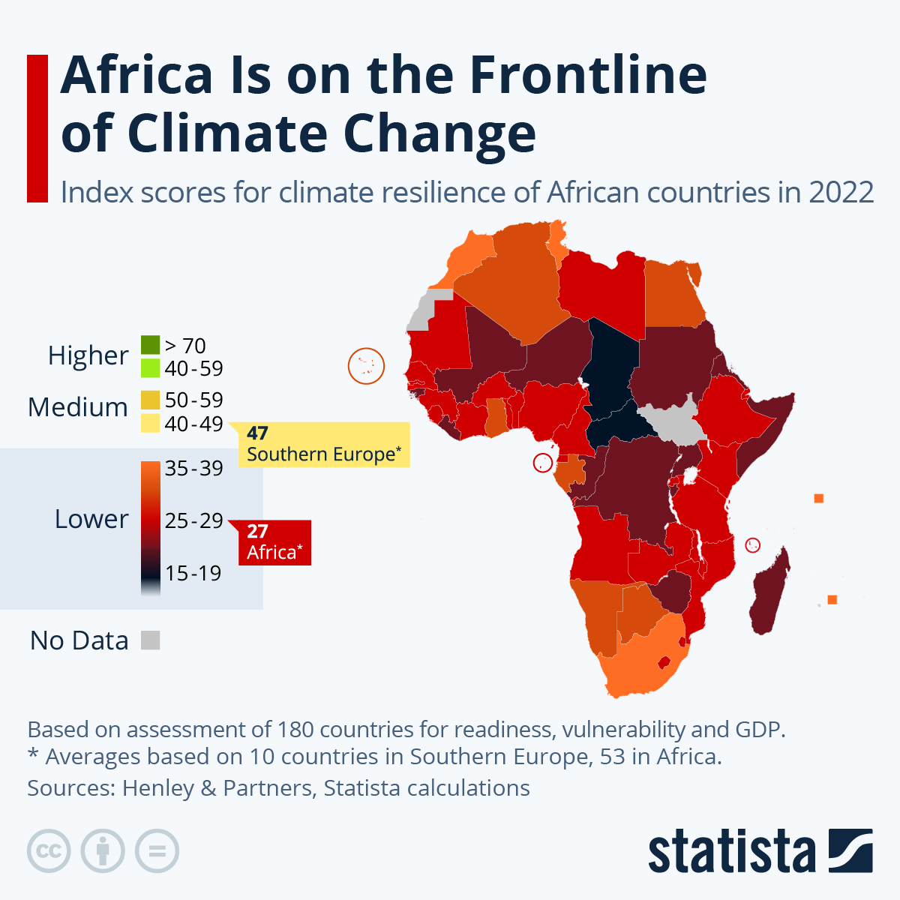
Climate Resilience
Nearly all African countries have committed to enhancing climate action through reducing their greenhouse gas emissions and building resilience.

Slide 11
Challenges and Solutions
Discuss challenges related to inadequate infrastructure, including transportation and storage facilities
Address the digital divide and limited access to modern agricultural technologies in some regions.
Strategies for improving technology access, such as partnerships and educational programs.
Smallholder farmers face challenges in accessing local and international markets.

Slide 12
Global impact
Leveraging African resources on a global scale.
Developments in Africa can contribute to the broader context of global food security
Addressing global hunger and malnutrition.
Potential for increased trade and economic partnerships on the global stage.
The role of Africa in promoting global sustainability through responsible resource management.

Slide 13
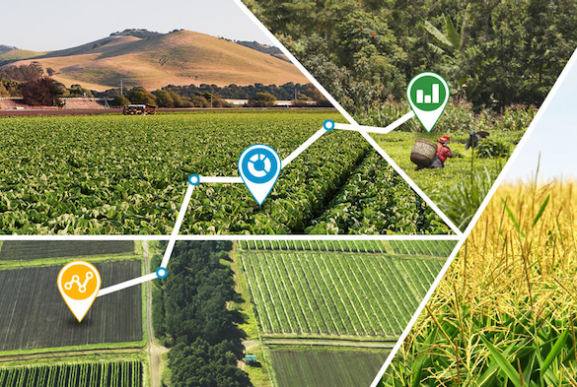
Future Prospects

Slide 14
Future Prospects
The role of precision farming, digital agriculture, and biotechnology.
Technology can improve productivity, resource efficiency, and sustainability.
Potential for increased international collaborations in agricultural research and development.
Strategies for enhancing climate resilience in African agriculture, the development of climate-resilient crop varieties and adaptation measures

Slide 15
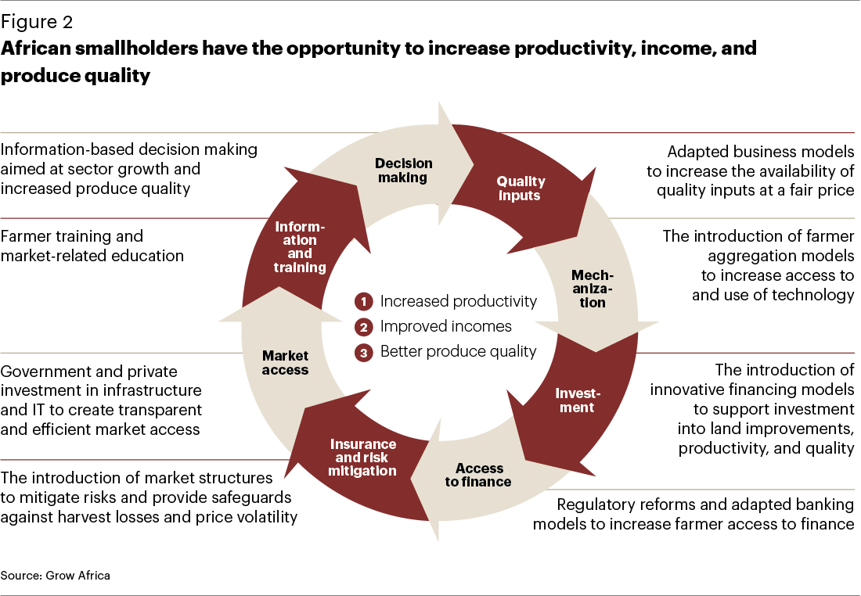
Opportunities
Text
Opportunities

Slide 16
Conclusion
As we navigate the intricate landscape of global food security, the abundant resources of Africa emerge not only as critical assets but as catalysts for positive change, necessitating collaborative efforts, sustainable practices, and innovative solutions to ensure a nourished and secure future for all

Slide 17
References
https://www.agriculture.gov.au/sites/default/files/sitecollectiondocuments/abares/publications/Outlook2012FoodDemand2050.pdf
file:///C:/Users/USER/Downloads/TheImpactofAgricultureonAfricanCivilizationinthe21stCen.pdf
https://www.digitalearthafrica.org/why-digital-earth-africa/water-resources-and-flood-risks
https://www.fao.org/3/cc3017en/online/state-food-security-and-nutrition-2023/food-security-nutrition-indicators.html

Slide 18
Thank you!

