Slide 1
Effects of nitenpyram pesticide on reproduction, development and metabolic gene expression profiles in Drosophila melanogaster insect
Prof. Dr. Mohamed Ahmed Ibrahim Ahmed
Professor in Plant Protection Department, Faculty of Agriculture, Assiut University, Assiut 71526, EGYPT

Slide 2
Contents
Introduction
Hypothesis
Material and Methods
Results
Conclusion

Slide 3
Introduction
Worldwide, pesticides are regarded as an essential component in the safe production of agricultural by helping to manage insect pests.
Due to their heavy and careless application, the regular use of conventional pesticides like pyrethroids, carbamates, and organophosphates to control insect pests has resulted in resistance development as well as negative impacts on the environment and human health.
Limiting the usage of chemical pesticides, which are thought to have an adverse effect on the environment, and planning ahead for pesticide substitutes are crucial.

Slide 4
Introduction
Neonicotinoids are thought to be among the best pesticides for managing pests, especially sucking insects.
Neonicotinoid pesticides work differently from other insecticides because they interact and bind to the nervous system's nicotinic acetylcholine receptors (nAChRs).
Negative effects on ecosystems can result from the overuse of neonicotinoid pesticides, which can contaminate soil, water, and air used for agriculture.

Slide 5
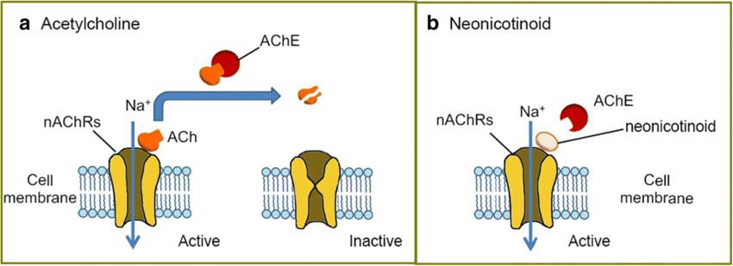
Introduction
Fig. 1: Mode of action of neonicotinoid pesticides.

Slide 6
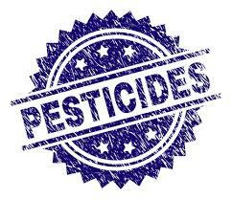
History of pesticides
2010th
More researchers focus on
the toxic effects of pesticides.
1970th
1990th
Pyrethroids and its safety on non-target organisms.
Neonicotinoids are based on
The natural insecticide, nicotine. It used in the control of pests.
1940th
DDT was first tried against mosquitoes that carried malaria.
1960th
Silent Spring book was a timely realization about the risks of DDT.

Slide 7
Aims of the study
To evaluate the toxicity of nitenpyram, an example of neonicotinoid pesticide, on Drosophila melanogaster third instar larvae and adults.
To examine the effects of sublethal concentrations of nitenpyram on detoxification enzymes, growth, development, and reproduction of D. melanogaster.
To assess the changes in gene expression related to development and metabolism.

Slide 8
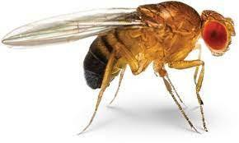
D. melanogaster as a model
5
D. melanogaster
has short
lifecycle, easy to maintain in culture in the laboratory, produces many eggs, and has a low number of chromosomes (only four pairs).
3
4
The structural and functional genome has been found to be comparable to the human genome.
Approximately 75% of the genes that are involved in the development of human diseases are evolutionarily conserved across animal species, including Drosophila.
1
Standard model for
Toxicological studies of xenobiotics in insects.
2
The genome of
The genome of D. melanogaster has been completely sequence.

Slide 9
Life cycle of D. melanogaster

Slide 10
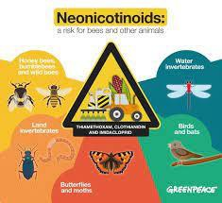
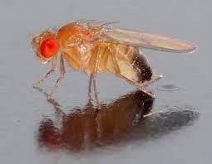
General hypothesis
Is the short exposure to nitenpyram and at low concentrations sufficient to induce significant physiological
disorders in animals, predictive of negative impacts on the health of the studied animal model?

Slide 11
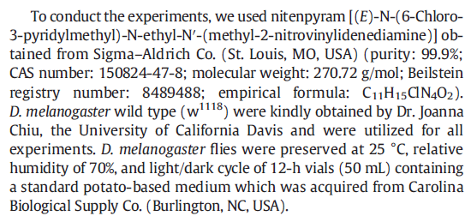
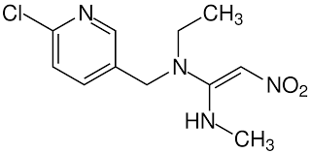
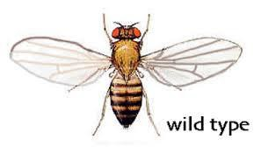
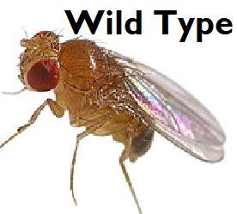
Insecticide and animal model

Slide 12
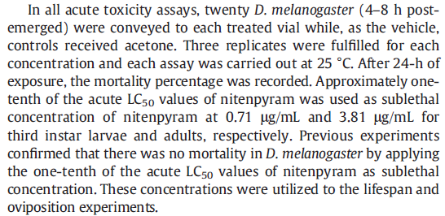
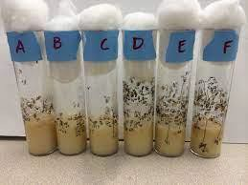
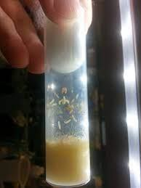
Acute toxicity assay

Slide 13
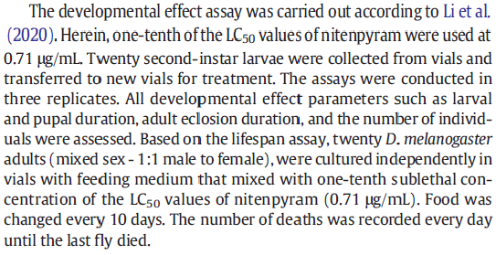
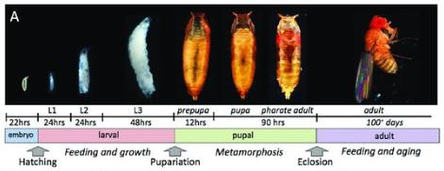
Developmental effect assay

Slide 14
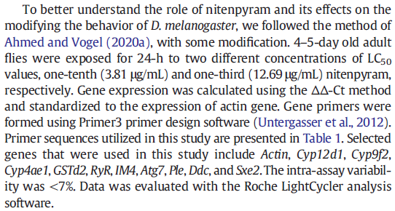
RNA extraction and quantitative real-time reverse transcriptase PCR (qRT-PCR)

Slide 15
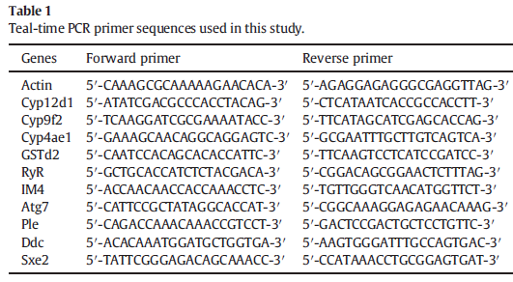
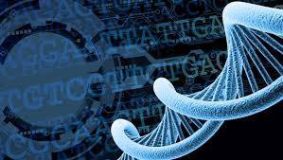
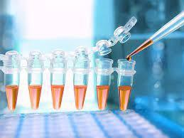
RNA extraction and quantitative realtime reverse transcriptase PCR (qRT-PCR)

Slide 16
RNA extraction and quantitative realtime reverse transcriptase PCR (qRT-PCR)
Gene | Associated with
CYP12d1 | Detoxification enzymes (P450)
CYP9f2
CYP4ae1
GSTd2 | Detoxification enzymes (GST)
RYR | Hemocyte proliferation
IM4 | Immune response
ATG7 | Lifespan
PLE | Male mating behavior
DDC | Female fertility
SXE2 | Lipid metabolism

Slide 17
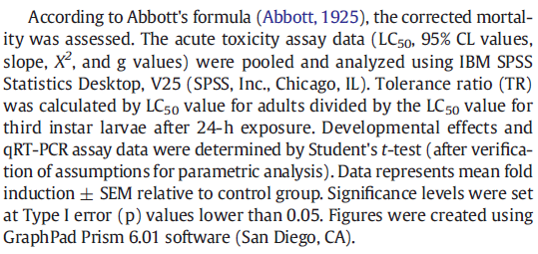
Statistical analysis

Slide 18
Results

Slide 19
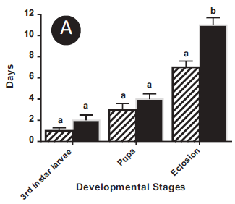
Results

Slide 20
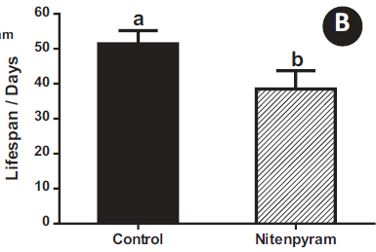
Results

Slide 21
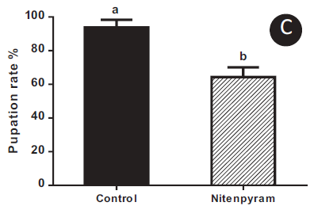
Results

Slide 22
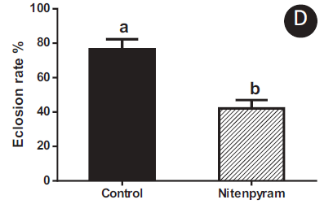
Results

Slide 23
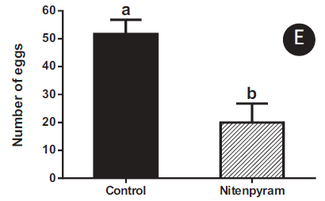
Results

Slide 24
Results

Slide 25
Results

Slide 26
Results

Slide 27
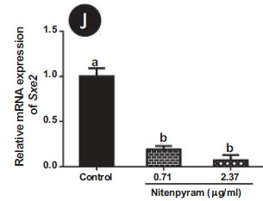
Results

Slide 28
Conclusion
Nitenpyram is more potent on larvae than adults of D. melanogaster.
Nitenpyram prolongs the developmental time for both pupation and eclosion.
Cyp12d1, Cyp9f2, Cyp4ae1, RyR, and IM4 genes were significantly upregulated.
Atg7, Ple, Ddc, and Sxe2 genes were significantly downregulated.

Slide 29
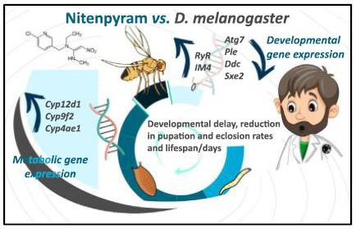
Conclusion

Slide 30
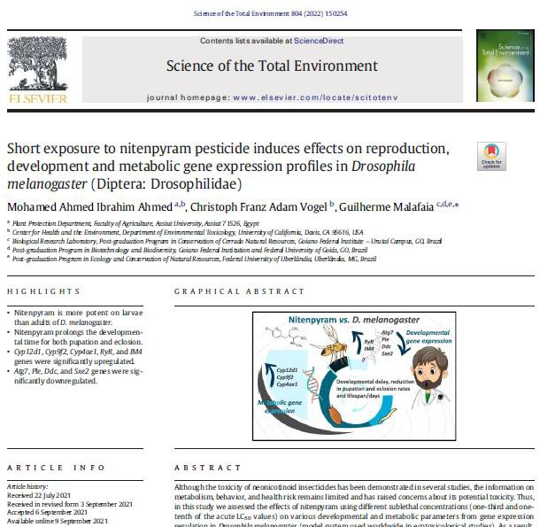
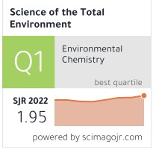
Publication

Slide 31
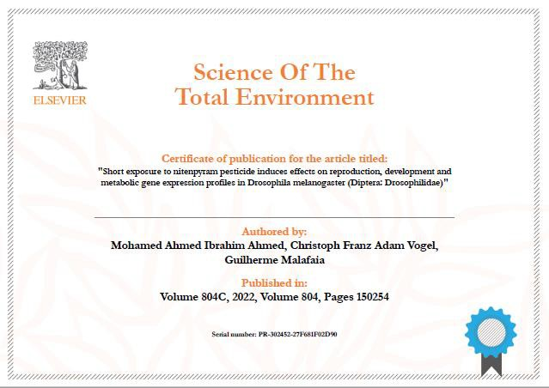
Publication

Slide 32
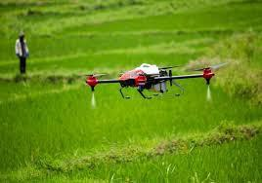
Prof. Dr. Mohamed Ahmed Ibrahim Ahmed E-mail: drmaiaf2000@aun.edu.eg
Mobile: +201113991177

Slide 33
Thank you!

