Slide 1
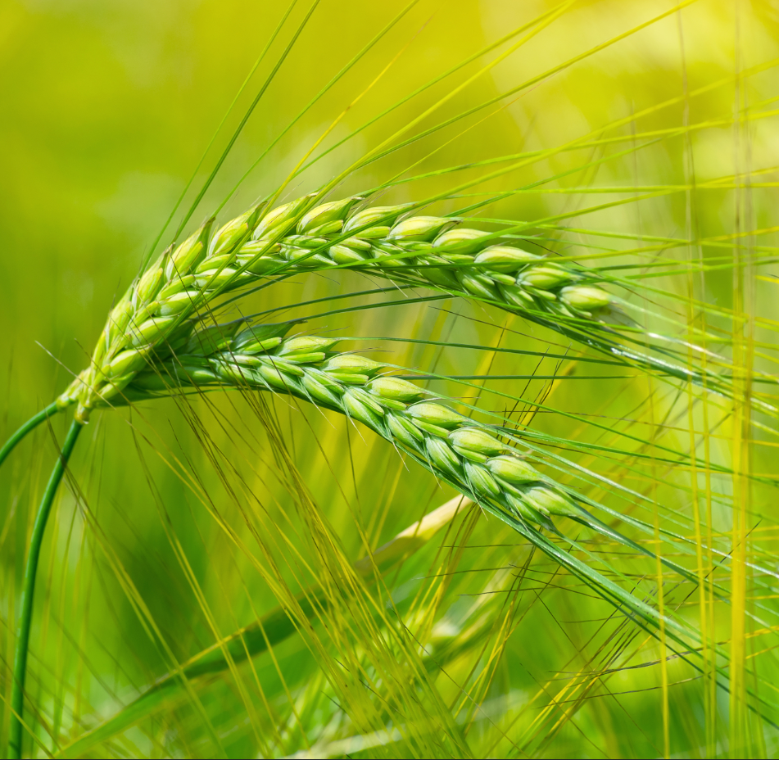
Digital services in agrobusiness
Elena Vorobeva, PJSC Phosagro

Slide 2
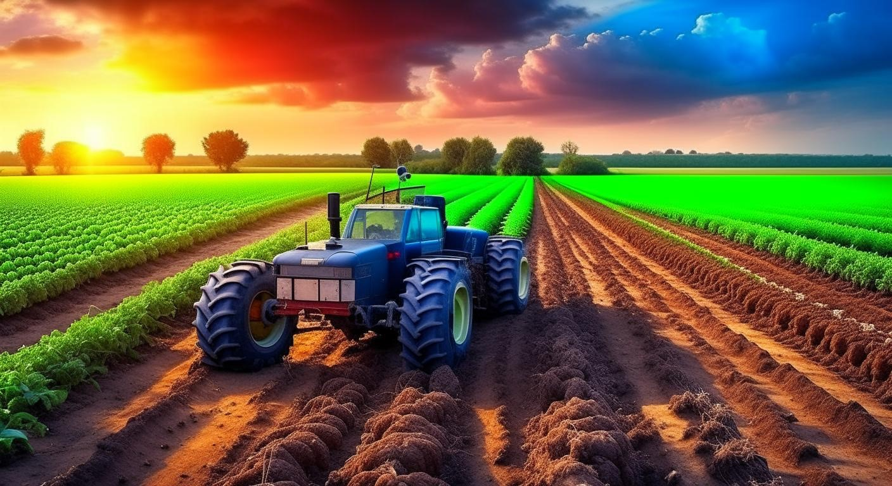
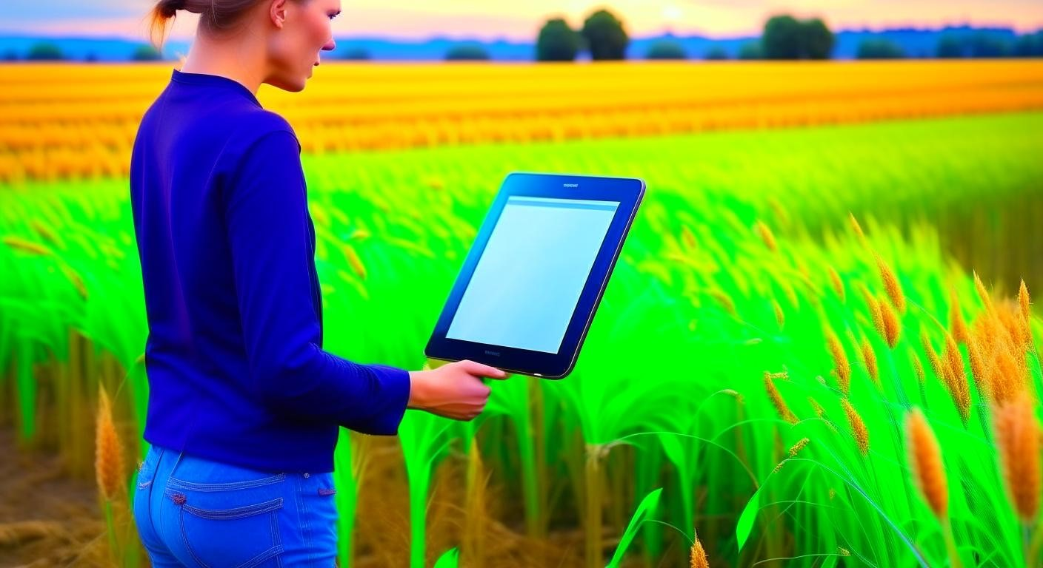
Why do we need the digitalization of agriculture?
Without digitalization, we will have nothing to eat as early as 2030.
In 2050, the population's demand for agricultural products will increase by 70%, while the climate and soil quality are deteriorating.
New resources for crop and livestock production are simply unavailable. If the agro-industrial complex is run at current resource productivity rates, food shortages will be critical as early as 2030.

Slide 3
Type of digital tools
Farm-level data derived from a combination of sources, including mobile-based agriculture apps, sensors, drones, farm implements and machinery, robotic devices, and other IoT devices, makes it possible for producers to capture vital farm data round the clock. This data, when processed with satellite and weather-based information, allows crop producers to monitor the growth of crops in real-time, assess the performance of the farm plots, and estimate the output for each farm plot with a fair amount of accuracy.
Precision agriculture presents diverse opportunities for the use of artificial intelligence to optimize farm processes. It allows producers to translate raw agri data into actionable insights that help improve the quality and quantity of the harvest. AI is also empowering producers to choose the best crops and crop varieties for their region, and leverage farm automation to minimize the use of resources.
The digitalization of the entire process, from production and harvest to warehousing and distribution, is strengthening communications between the various stakeholders in the agri-ecosystem. Digitalization has also enhanced visibility along the supply chain for the different actors, making the process more transparent and highly efficient.

Slide 4
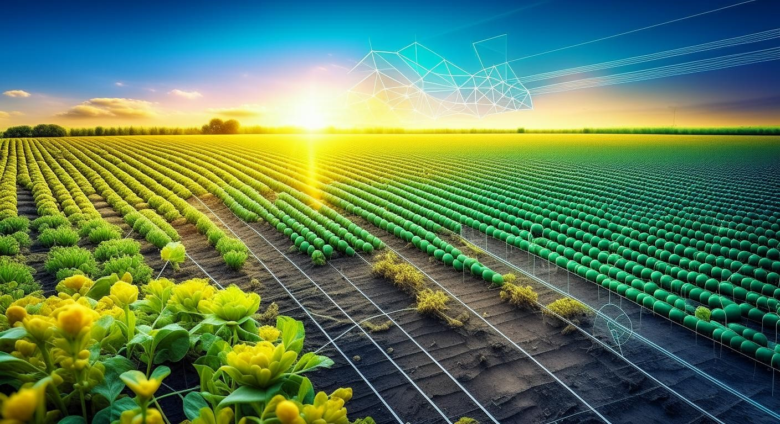

What is the impact of being digital in the agriculture sector?
Increased productivity
Farms that have adopted technological innovations have demonstrated a clear shift from the use of traditional, time-consuming processes to more advanced and cost-efficient operations.
Enhanced farmer livelihood
Digital farming plays a vital role in understanding crop science and improving agronomic practices to yield better outputs. The use of agri-technology improves farm productivity and helps reduce losses due to crop stresses such as pests, diseases, and unpredictable weather conditions. As a result, farmers can realize better profits at the end of each season. Digital tools also enables producers to meet quality standards set by international certification bodies, which further makes it a possibility for farmers to fetch a premium price for their produce.

Slide 5
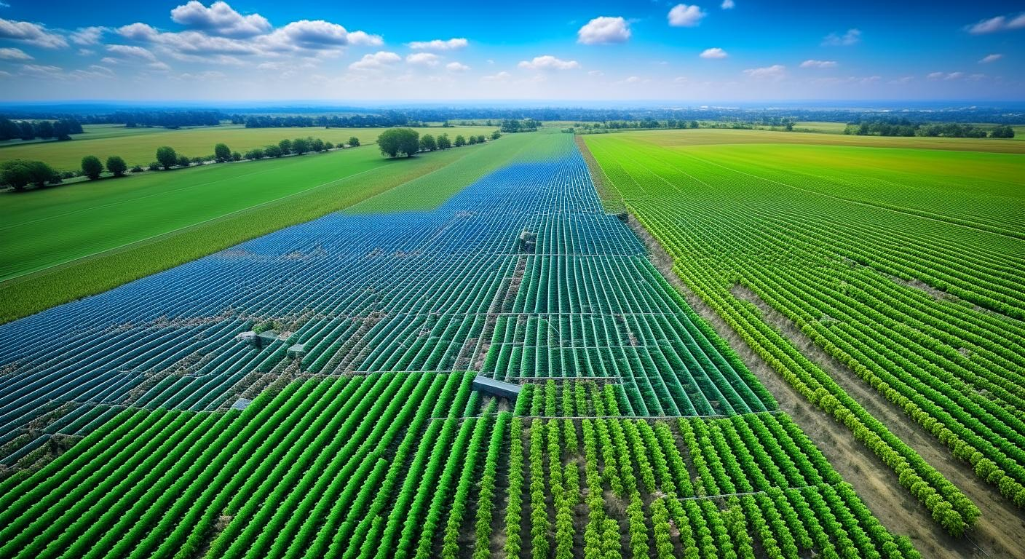
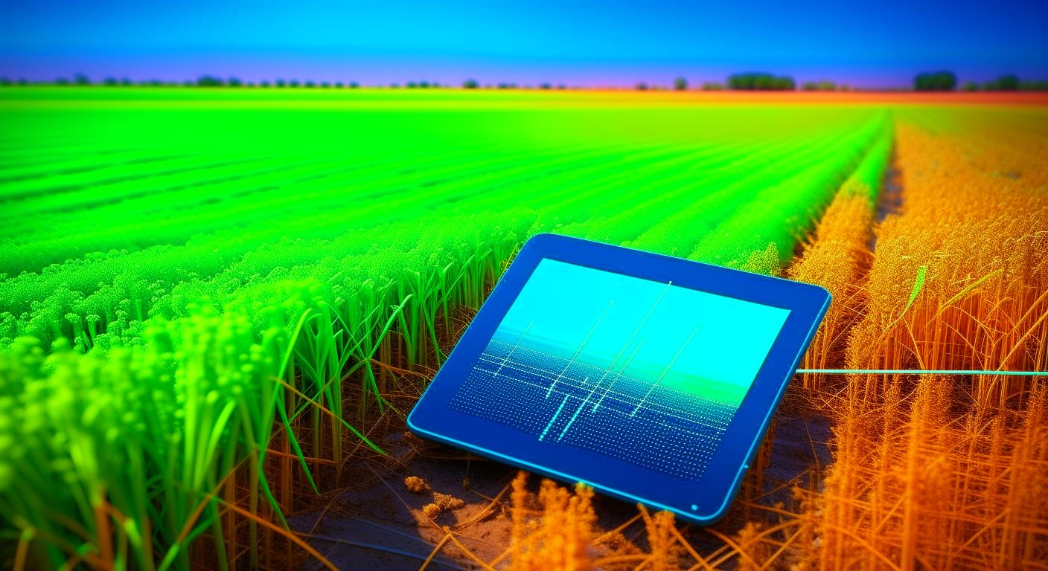
What is the impact of being digital in the agriculture sector?
Informed decision-making
Yet another remarkable benefit of adopting a digital agriculture system is that it provides users with accurate near-real-time data. An aggregate of farm and satellite-imaging-based intelligence provides actionable insights on productivity based on a wide array of growing conditions, thus permitting producers to plan farm operations better and manage resources more effectively.
Implementation of centralized database
A sharp rise in mobile and internet penetration has brought millions of farmers on the radar of policymakers. Digital innovations provide the opportunity for government entities to create a centralized database, wherein the details of farmers across each state or the entire country are made available. Having farmers register their details will also ensure that they get timely updates on agriculture-related schemes that are most relevant to them, to aid in their upliftment

Slide 6
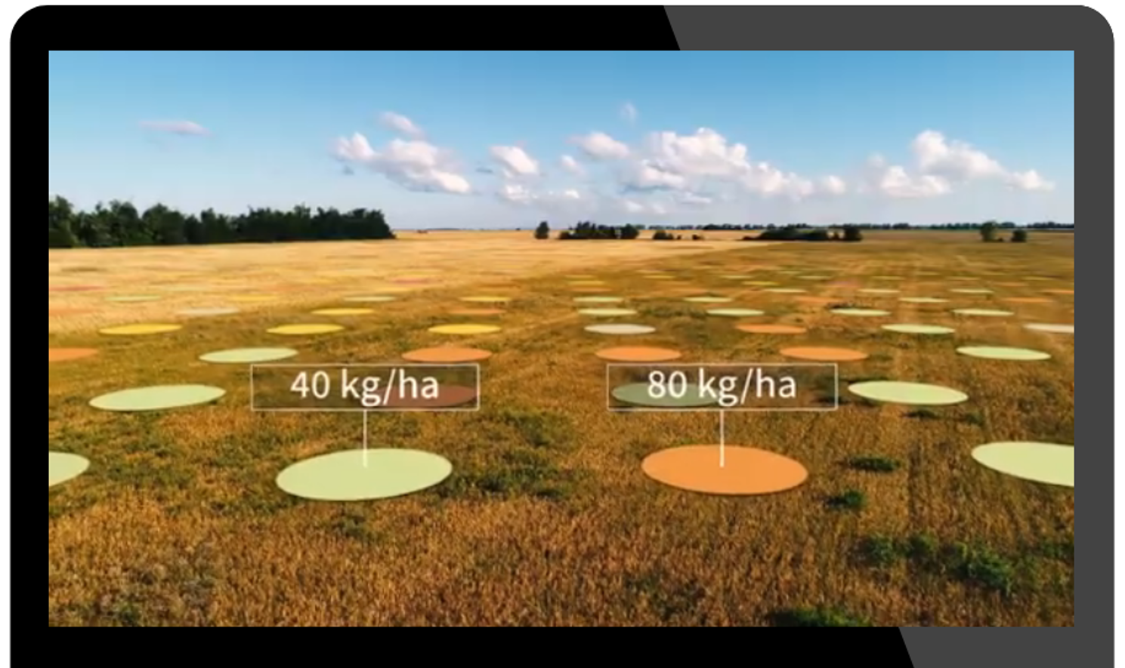
Examples of digital tools in the agriculture sector
Yara’s AtFarm - the technology that measures the crop growth of your fields using satellite technology. The algorithm looks for growth differences and based on that creates variable application maps for your N-fertilisation.

Slide 7
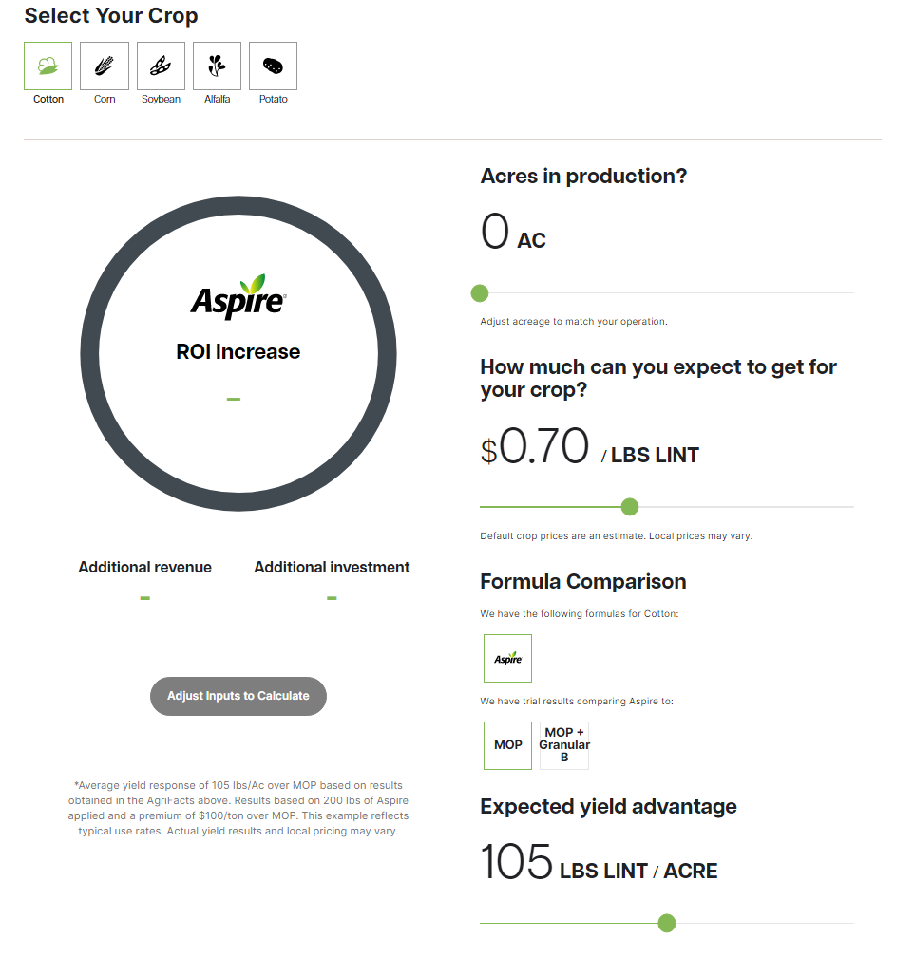
Examples of digital tools in the agriculture sector
Mosaic calculator helps to calculate your ROI. Fertilizer producer says that in a single granule, Aspire® fertilizers combines potassium with two forms of boron for season-long availability and uniform nutrient distribution across the entire field. It helps to learn what ROI you could be missing out on by not using Aspire.

Slide 8
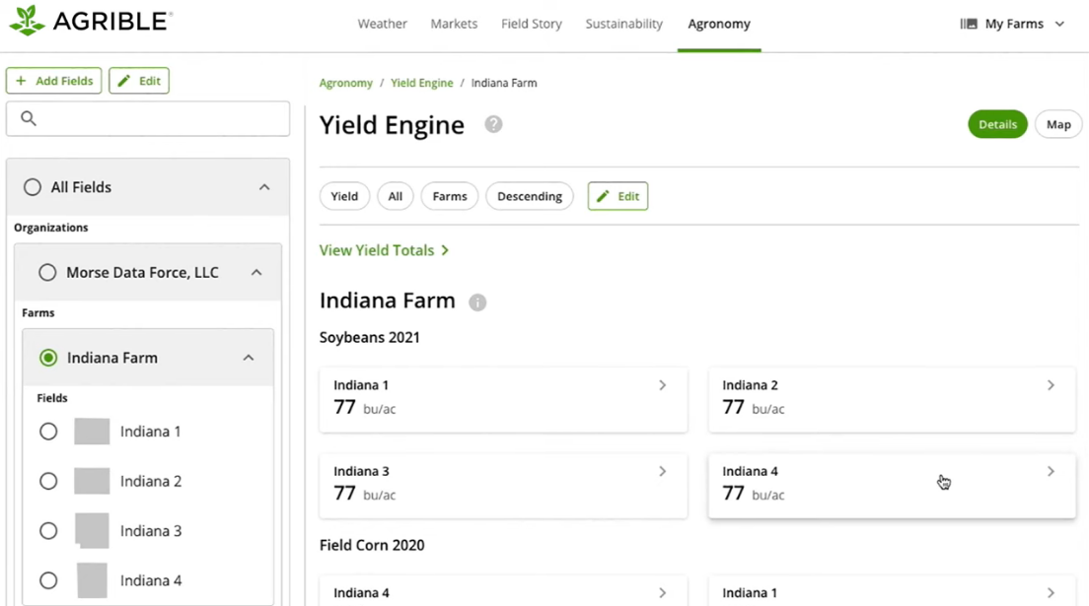
Examples of digital tools in the agriculture sector
Nutrien’s Аgrible - a digital platform that allows
to view field-level weather forecasts
to access real-time projections on yield and soil fertility
to plan agri works

Slide 9
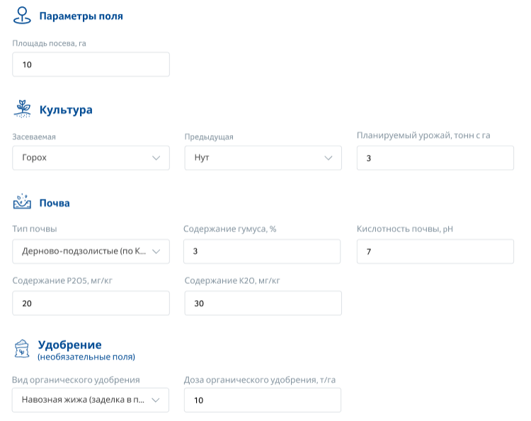
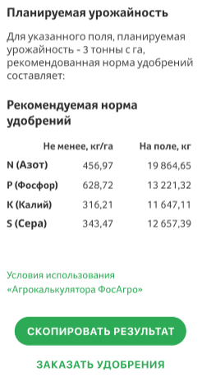
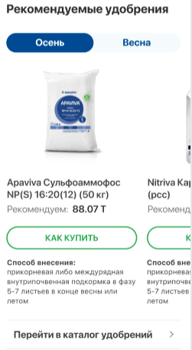
Phosagro Agricultural Calculator

Slide 10


Phosagro Agricultural Calculator
Web version of Agricultural Calculator
Mobile version of Agricultural Calculator (AgroResult)

Slide 11
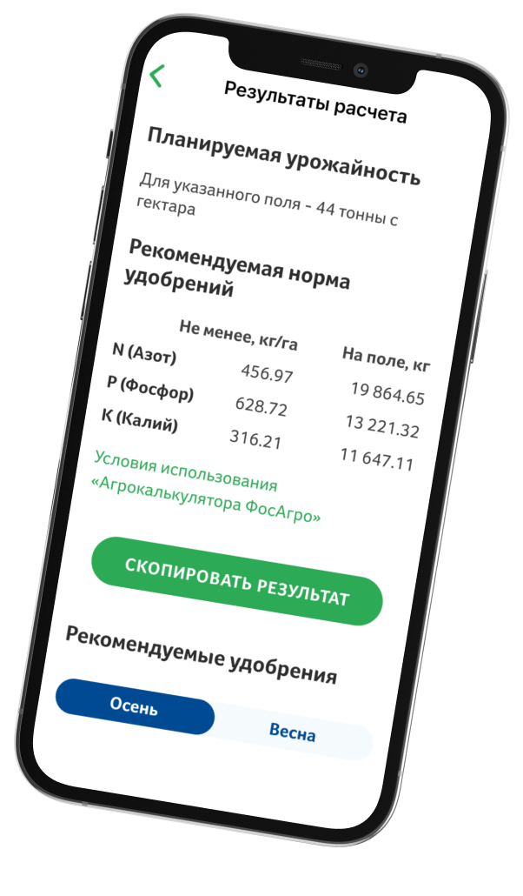
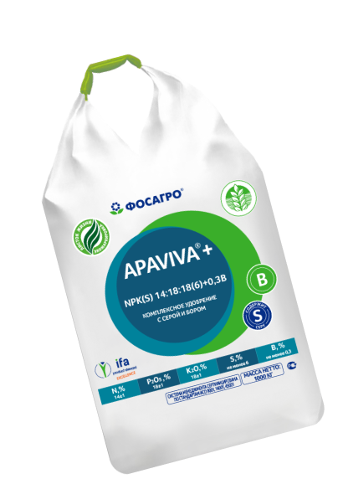
Phosagro Agricultural Calculator: calculation algorithm
Agrocalculator uses algorithms based on the results of many years of research by renowned research institutes in the field of agrochemistry.
The calculation algorithms are based on the formulas of the balance method and data on soil peculiarities according to the selected region.
Using the Agrocalculator you can increase the accuracy of the calculation by filling real data in the required fields with.

Slide 12
Where to get a requested data?
COOPERATION with FAO
Since 2018, PhosAgro together with the Food and Agriculture Organization have been implementing a global project to expand soil laboratory networks in Africa, Asia, Latin America and the Middle East and improve farmers' skills in sustainable soil management.
In 2019, the soil laboratory network AFRILAB was launched in 48 African countries.
In October 2020, PhosAgro supported the launch of the Global Soil Doctors Programme – a global initiative to improve the competencies of farmers in sustainable agriculture

Slide 13
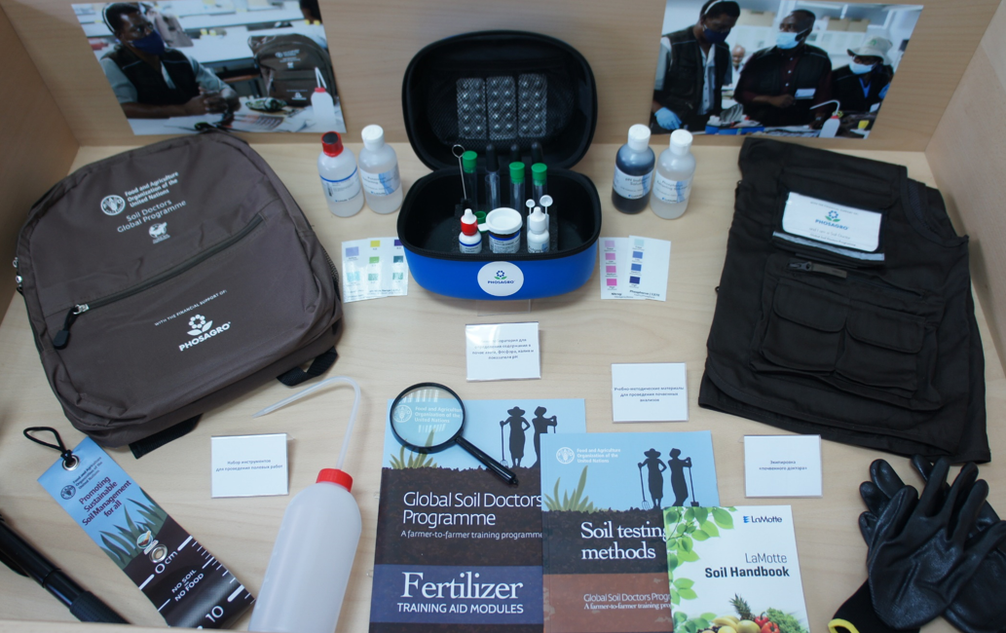
Where to get a requested data?
COOPERATION with FAO
The Soil Doctors Testing Kits - special kits for assessing soil condition – were developed and distributed among farmers
Project participants globally – 5 000+ farmers, 800+ soil laboratories

Slide 14
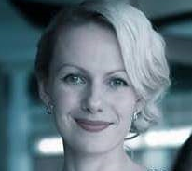
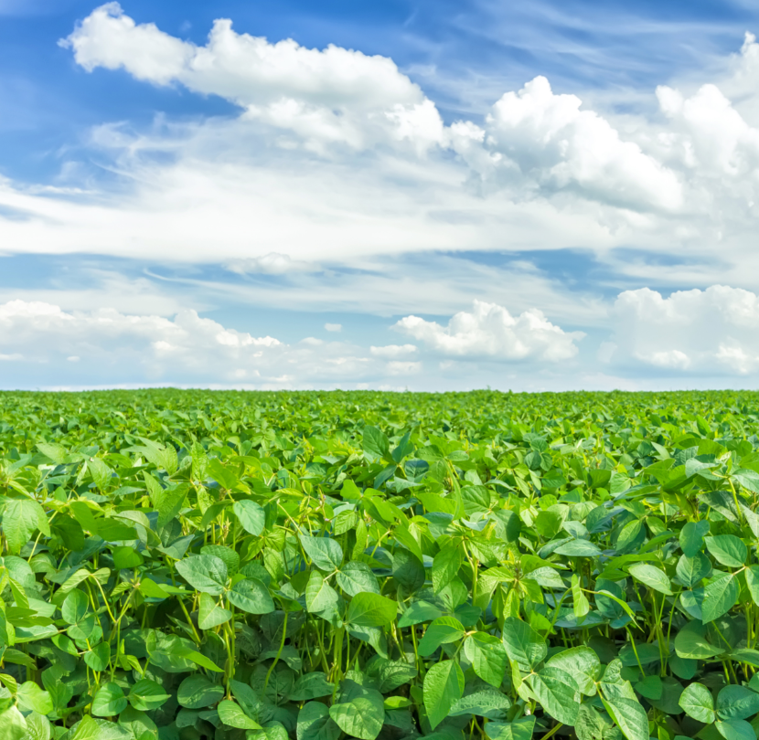
Elena Vorobyeva
PJSC Phosagro, Head of Digital evorobyeva@phosagro.ru

Slide 15
Thank you!

