Slide 1
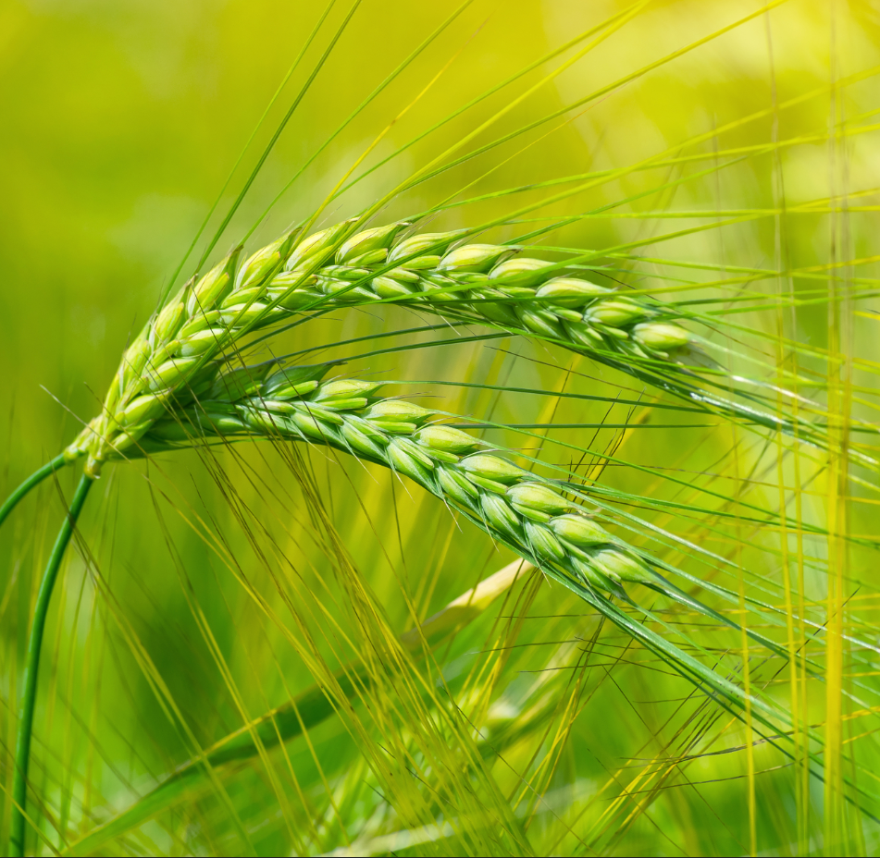
Development of plant growth regulators for habanero pepper from Yucatan Peninsula through an eco-friendly chemical transformation of steroidal sapogenins
María A. Fernández-Herrera, Cinvestav-Merida

Slide 2
Purpose of the project
Sustainable chemical synthesis of bioactive molecules for local agriculture (habanero pepper).
Targets a key regional crop in the Yucatan Peninsula, vital to the economy (90% from Yucatan state).
Habanero pepper is the 5th most important global crop (FAO), valued for nutrition, vitamins, and natural colorants.
Synthesis guided by six Green Chemistry principles to ensure sustainability.
Eco-friendly synthesis of steroidal phytohormones (cholestanes) to enhance crop growth and promote sustainable agricultural development.

Slide 3
Project aims
Immediate-Term Aims (12-Month Project):
Open plant-derived steroid side-chains via Lewis acid-catalyzed acetolysis (26-hydroxy-22-oxocholestanes), applying Green Chemistry principles.
Mild oxidation of the C-26 primary hydroxyl group to corresponding steroidal aldehydes.
Perform C-C bond cleavage of aldehydes via a microwave-assisted, water-promoted, aniline-catalyzed reaction (27-norcholestanes).
Utilize resulting 1,4-dicarbonyl compounds to synthesize a series of steroidal pyrroles without catalysts.
Design optimal delivery formulations using soy lecithin and water for habanero pepper seedlings.
Test all synthesized steroidal compounds as plant-growth regulators in habanero pepper crops.
Publish results.

Slide 4
Project aims
Longer-Term Perspectives:
File a patent covering all chemical and biological results.
Conduct expanded toxicity assessments in other plants, bees, water, and livestock via authorized institutions.
Evaluate other delivery systems/formulations for plants.

Slide 5
Background - Phytohormones & Plant Growth Promoters
Phytohormones are chemical substances produced by plants that regulate physiological growth processes.¹
They are synthesized in tiny amounts, making them precious targets for organic synthesis.
Brassinosteroids (BSs) are the most sophisticated and potent class of phytohormones.
  First identified in 1979 (brassinolide) from Brassica napus pollen.²
  Over 70 natural BSs are known, with hundreds of synthetic analogs produced.³
Their chemical structure is key to activity, with specific functional groups essential for their biological effects.
1. a) Brassinosteroids: A Class of Plant Hormone, in: S. Hayat, A. Ahmad (Eds.) Springer Dordrecht, 2011. b) V.A. Khripach, V.N. Zhabinskii, A.E.d. Groot, Brassinosteroids: a new class of plant hormones, Academic Press, San Diego, 1999. c) Brassinosteroids: steroidal plant hormones, in: A. Sakurai, T. Yokota, S.D. Clouse (Eds.) Springer, Tokyo, 1999.
2. M.D. Grove, G.F. Spencer, W.K. Rohwedder, N. Mandava, J.F. Worley, J.D. Warthen, G.L. Steffens, J.L. Flippen-Anderson, J.C. Cook. Brassinolide, a plant growth-promoting steroid isolated from Brassica napus pollen. Nature 1979, 281, 216-217.
3. A.L.G.L. Peres, J.S. Soares, R.G. Tavares, G. Righetto, M.A.T. Zullo, N.B. Mandava, M. Menossi. Brassinosteroids, the Sixth Class of Phytohormones: A Molecular View from the Discovery to Hormonal Interactions in Plant Development and Stress Adaptation. Intl. J. Mol. Sci. 2019, 20, 331(1-33).

Slide 6
Background - Structural Features of Steroidal Phytohormones
Steroidal phytohormones feature oxygenated functional groups in rings A, B, and the side chain; nitrogen can occasionally be found.
The modification of these functional groups (pharmacophores) can increase or decrease the hormone's biological activity.
Key structural characteristics:
  Almost all contain an oxygenated group at C-3.
  Side-chain structure is crucial and variable, with some possessing atypical stereochemistry.
brassinolide

Slide 7
Background - The 22-Oxocholestane Scaffold: A Molecule with Dual Potential
The 22-oxocholestane scaffold gained prominence with the discovery of OSW-1, a potent natural product.⁴
  OSW-1 is a cholestane saponin from Ornithogalum saundersiae.
  It exhibits remarkable anticancer activity (up to 100x greater than taxol).⁵
This finding spurred research into synthesizing OSW-1 analogs for various biological applications.
Other natural products, like the abutilosides from Solanum abutiloides, also feature this side chain.⁶
4. S. Kubo, Y. Mimaki, M. Terao, Y. Sashida, T. Nikaido, T. Ohmoto. Acylated cholestane glycosides from the bulbs of Ornithogalum saundersiae. Phytochemistry 1992, 31, 3969-3973.
5. a) Y. Mimaki, M. Kuroda, A. Kameyama, Y. Sashida, T. Hirano, K. Oka, R. Maekawa, T. Wada, K. Sugita, J.A. Beutler. Cholestane glycosides with potent cytostatic activities on various tumor cells from Ornithogalum saundersiae bulbs. Bioorg. Med. Chem. Lett. 1997, 7, 633-636. b) Y. Zhou, C. Garcia-Prieto, D.A. Carney, R.-h. Xu, H. Pelicano, Y. Kang, W. Yu, C. Lou, S. Kondo, J. Liu, D.M. Harris, Z. Estrov, M.J. Keating, Z. Jin, P. Huang. OSW-1: A Natural Compound With Potent Anticancer Activity and a Novel Mechanism of Action. J. Natl. Cancer Inst. 2005, 97, 1781-1785.
6. a) E. Ohmura, T. Nakamura, R.H. Tian, S. Yahara, H. Yoshimitsu, T. Nohara. 26-Aminocholestanol derivative, a novel key intermediate of steroidal alkaloids, from Solanum abutiloides. Tetrahedron Lett. 1995, 36, 8443-8444. b) R.H. Tian, E. Ohmura, H. Yoshimitsu, T. Nohara, M. Matsui. Cholestane Glycosides from Solanum abutiloides. Chem. Pharm. Bull. 1996, 44, 1119-1121. c) H. Yoshimitsu, M. Nishida, T. Nohara. Cholestane Glycosides Solanum abutiloides. III. Chem. Pharm. Bull. 2000, 48, 556-558.
OSW-1

Slide 8
Background - Previous Synthesis & Our Group's Innovation
Traditional syntheses of the 22-oxocholestane side chain built it from pregnane or androstane skeletons.
Our research group pioneered a more efficient, one-pot synthesis starting from spirostanes (plant-derived sapogenins).
  This method converts the spiroketal side chain through an atom-economical process.
Critically, we identified that these synthetic 22-oxocholestanes function as plant growth promoters.
Literature indicates that oxygenated and heterocyclic (e.g., pyrrole) functions enhance plant-growth activity.
22-oxocholestane side chain

Slide 9
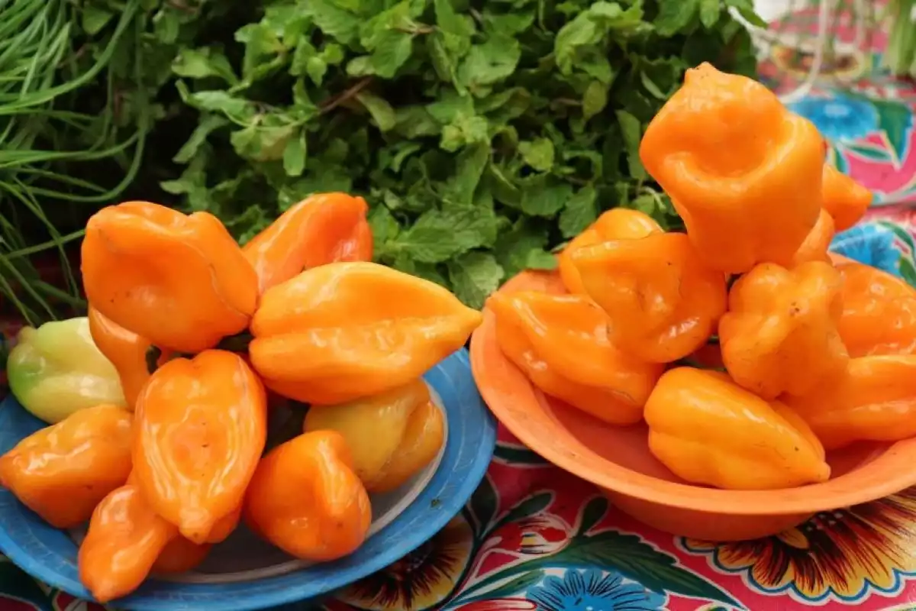
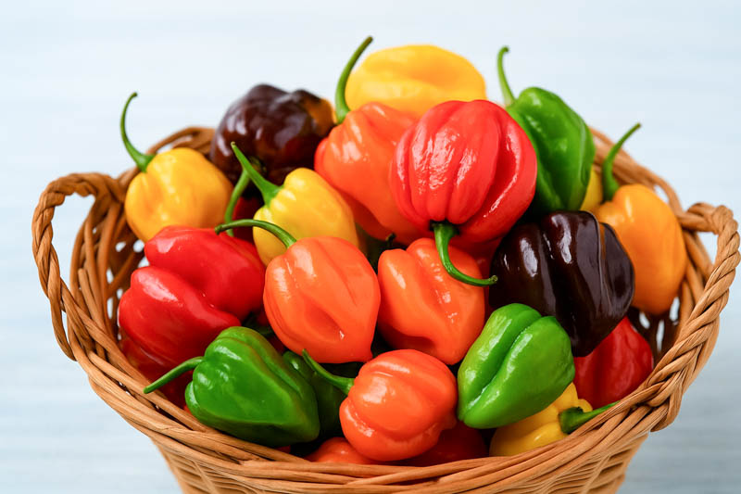
Background - Project Rationale & Target Crop
Synthesize a new series of 27-norcholestane and steroidal pyrrole compounds derived from 22-oxocholestanes.
To mimic natural phytohormones and develop potent, sustainable plant growth promoters.
Habanero pepper (Capsicum chinense) from the Yucatan Peninsula.
  An economically vital crop for small-scale farmers in the region.
  A valuable source of income for rural families, making sustainable yield improvement a priority.

Slide 10
Pyrroles
Pyrroles are highly significant heterocycles found in a wide array of natural products, pharmaceuticals, and advanced materials, driving ongoing research into new synthetic methods and supramolecular complexes.
Notable natural pyrrole derivatives include essential biological molecules like porphyrins, chlorophylls, and bile pigments. A classic method for pyrrole synthesis is the Paal-Knorr reaction, which transforms 1,4-dicarbonyl compounds into pyrroles via acid-catalyzed cyclization with a primary amine. However, this reaction often requires harsh conditions, presenting a persistent synthetic challenge.

Slide 11
Pyrroles
Pyrroles can be integrated into steroidal frameworks either as side-chain substituents or fused to the core. Various methodologies have been developed for this purpose.
Recent work includes the development of steroidal heterocycles with demonstrated anticancer activity. Additionally, research extends to the synthesis of complex structures like pyrrolosteroidal dienes, spiroannulated macrocycles, and steroid-porphyrin conjugates, which are important in supramolecular chemistry.
Pyrroles directly fused to the steroidal core are less common. Early work by Mueller and Jiu employed harsh conditions to apply the Paal-Knorr reaction to a steroidal substrate. A more recent advance by Davies and colleagues demonstrates a methodology to convert cyclic ketones into 2,3-fused pyrroles, successfully applying it to complex steroidal frameworks like cholestene derivatives, thereby attaching the heterocycle directly to ring A.⁷
7. Mueller, G.P.; Jiu, J. The Synthesis of Steroid Ring-E Pyrroles and Pyrrolidines. J. Org. Chem. 1961, 26, 1611–1614, doi:10.1021/jo01064a074. b) Alford, J.S.; Spangler, J.E.; Davies, H.M.L. Conversion of Cyclic Ketones to 2,3-Fused Pyrroles and Substituted Indoles. J. Am. Chem. Soc. 2013, 135, 11712–11715, doi:10.1021/ja405043g.

Slide 12
Pyrroles
Synthesis
Revisiting the classic Paal-Knorr reaction to create novel fused pyrrole rings in cholestane and norcholestane side chains, starting from natural sapogenins (kryptogenin, diosgenin).
Employing both conventional and microwave-assisted heating for efficient synthesis.
Biological Evaluation and Dual Application:
Acaricidal Potential:
  The two-spotted spider mite (Tetranychus urticae) is a major global pest, and resistance to conventional pesticides is a growing issue.
  Pyrrole-containing steroids could serve as new, potentially safer acaricide candidates, inspired by compounds like chlorfenapyr.
Plant Growth Regulation:
  While steroidal phytohormones (e.g., brassinosteroids) are known growth promoters, pyrrole-containing steroids remain largely unexplored in agriculture.
  Evaluate these new compounds as plant growth regulators for habanero pepper (Capsicum chinense), a key regional crop.
To synthesize a new class of steroidal pyrroles and assess their dual agrochemical potential as both miticides and plant growth promoters, contributing to sustainable agriculture.

Slide 13
Chemical Synthesis Strategy and Optimization
Historical context and our approach
Early syntheses of steroidal pyrroles required harsh conditions (e.g., high pressure/temperature in autoclaves).
Revisit and optimize the Paal-Knorr reaction for kryptogenin and extend it to norcholestanes from diosgenin.
Key Synthetic Steps
Diacetylation of kryptogenin to prevent an unwanted side reaction and allow the Paal-Knorr to proceed.
Reaction of the protected diketone (2) with primary amines via the Paal-Knorr reaction.
  The amines tested were benzylamine (a), ethanolamine (b), propanolamine (c).
  The heating methods compared were conventional reflux vs. microwave (MW) heating.
Optimization of Reaction Conditions
Screened various solvents and p-TsOH as catalyst using benzylamine (a).
DMF caused decomposition; optimal temperature was 150 °C.
Toluene provided the highest yield for the model reaction.
Under optimized conditions (toluene, reflux), all three amines (a-c) successfully yielded the target pyrroles 3a-c.

Slide 14
Chemical Synthesis Strategy and Optimization
Effect of different solvents on synthesizing the fused cholestane pyrrole 3a at reflux.
Entry | Solvent^{[a]} | Reaction time (h)^{[b]} | Yield of 3a (%)^{[c]}
1 | acetonitrile | 6 | 38
2 | ethanol | 6 | 45
3 | toluene | 5 | 80
4 | xylene | 5 | 65
5 | DMF | 6 | 32
[a] All the reactions were conducted at reflux, except for DMF where the temperature was kept controlled at 150 °C, as at higher temperatures, multiple degradation products were observed. [b] Maximum yield occurred within these reaction times. [c] Isolated yields.
De los Santos, M. G., Cua-Basulto, M., Huepalcalco, A., Delit, W., Sandoval-Ramírez, J., López-Torres, A., ... & Fernández-Herrera, M. A. (2022). Fused Pyrroles in Cholestane and Norcholestane Side Chains: Acaricidal and Plant Growth-Promoting Effects. Molecules, 27(23), 8466.

Slide 15
Synthesis optimization and application to norcholestanes

Slide 16
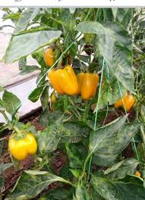
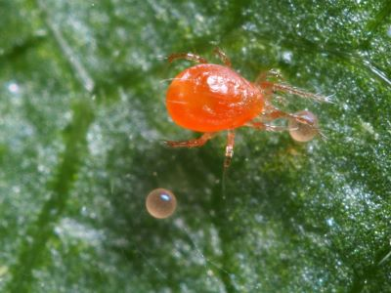
Biological evaluation, acaricidal activity
Two-spotted spider mite (Tetranychus urticae) was the target
Norcholestane pyrroles 8a-c
Activity on Adult Mites:
  Compounds 8a and 8b showed significant mortality 24 hours after application.
  All compounds (8a-c) caused significant mortality at 48 and 72 hours.
  Most Effective: Compound 8c had the strongest lethal effect at 72 hours.
Activity on Mite Eggs:
  Compounds 8b and 8c caused significant egg mortality.
  Most Effective: Compound 8c showed a highly lethal effect on eggs.
Residual activity and context:
Based on literature for similar pyrrole compounds (e.g., chlorfenapyr), these steroidal pyrroles are expected to have a residual activity of 1-3 weeks after application.
Note: Actual residual time can vary with plant species, age, and environmental conditions.

Slide 17
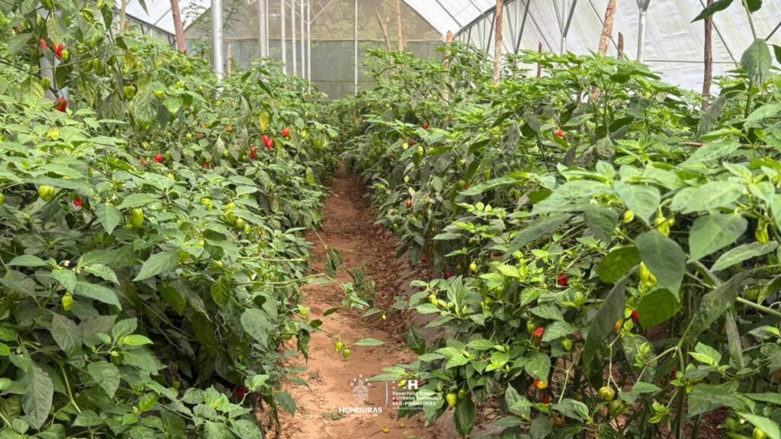
Biological evaluation, effect on habanero pepper growth
Assess the impact of norcholestane pyrroles 8a-c on vegetative growth.
Habanero pepper (Capsicum chinense), greenhouse conditions, direct foliar spray
Measured 15 days after treatment
Results on Vegetative Growth:
No Significant Effect was observed on plant height and number of leaves per plant
Key Positive Finding on Biomass:
Root Dry Biomass was significantly increased.
Most Active Compound: 8c
  Treated: 0.15 g/plant
  Control: 0.10 g/plant
This suggests 8c promotes root system development.
Significance & Future Direction:
Root growth is tightly regulated by phytohormones.
This result indicates the potential of 8c as a phytohormone-like regulator.

Slide 18
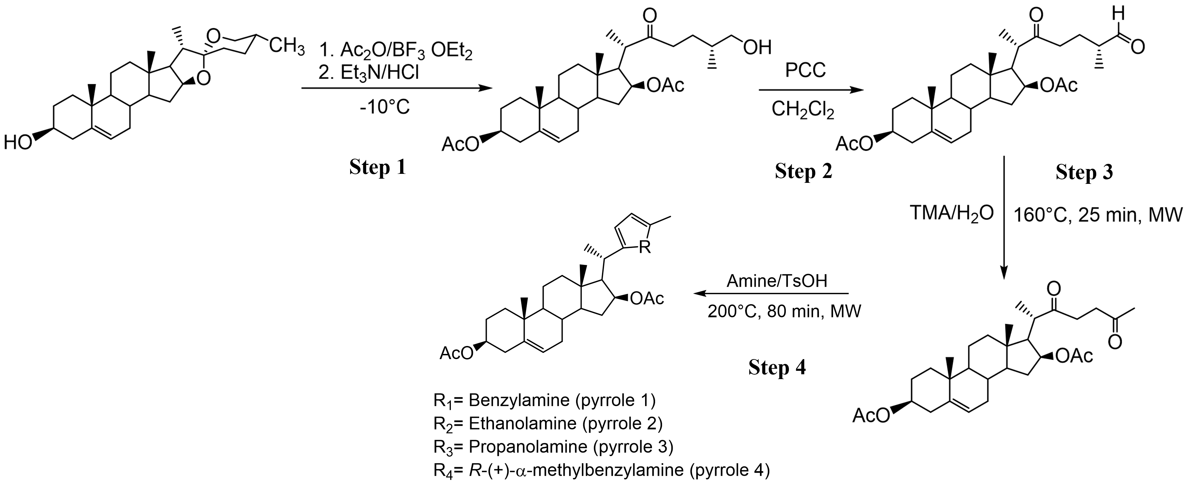
The C-C bond cleavage
The Water is the cheapest and most environmentally friendly solvent.
At high temperatures, superheated water is obtained, which is defined as water that maintains its liquid state under pressure at a temperature above its natural boiling point (100 °C) and below its critical temperature (374 °C).
In this state, the solubility of organic compounds increases due to the change in their chemical and physical properties:
The dissociation constant (pKw) decreases from 14 to 11 and increases at its critical point.
The polarity decreases.
The dielectric constant decreases to 27.5.

Slide 19
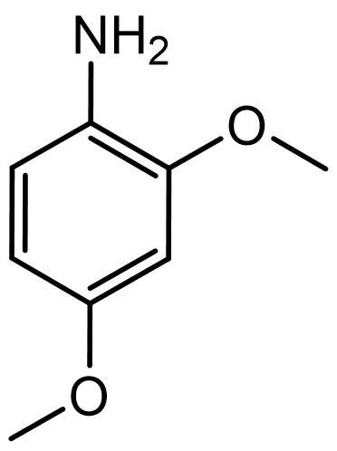
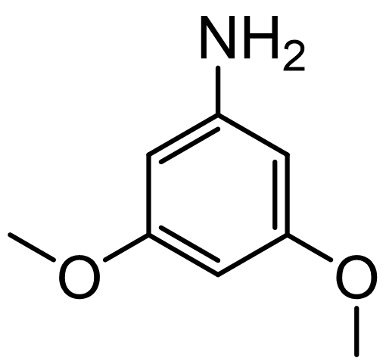
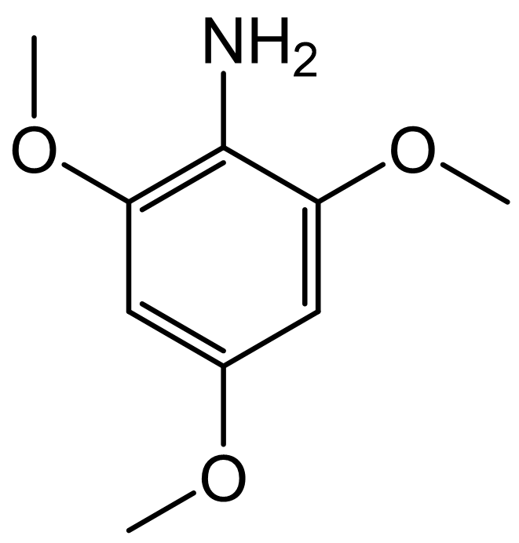
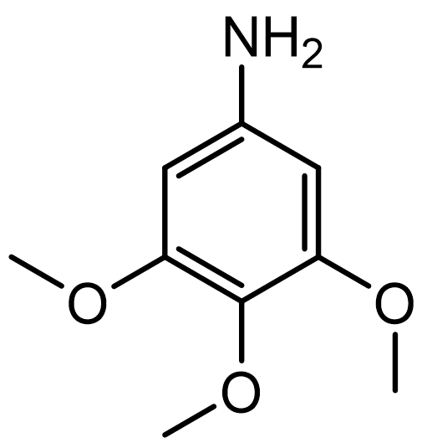
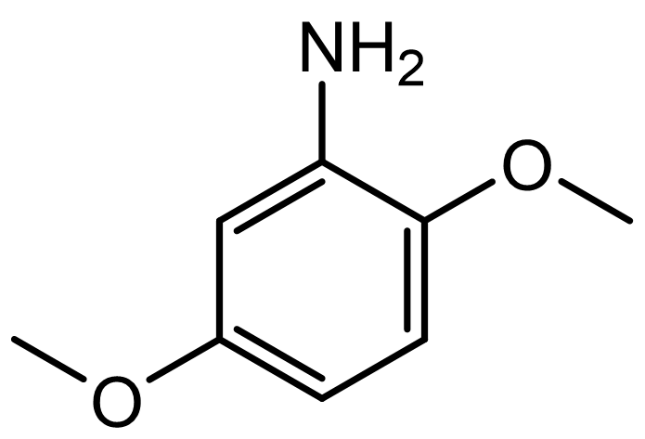
The C-C bond cleavage
Cleavage of the C-C bond between carbon C-25 and C-26 using electron-rich anilines.
The spectroscopic data confirmed the obtaining of the system 27-norcholestane, which contains a 1,4-dicarbonyl system. The yields obtained with each aniline for the formation of the 1,4-dicarbonyl system vary between 45 and 90%.
2,4-dimethoxyaniline
2,5-dimethoxyaniline
3,5-dimethoxyaniline
2,4,6-trimethoxyaniline
3,4,5-trimethoxyaniline

Slide 20
Conclusions
Synthetic Achievements:
Successfully synthesized fused pyrroles in cholestane and norcholestane side chains.
Optimized the Paal-Knorr reaction using mild, efficient methods (conventional reflux & MW-heating with SiC vials).
Constructed the norcholestane skeleton from diosgenin via a key C-C bond cleavage to form the essential 1,4-dicarbonyl precursor.
Biological Results – Dual Agro-Potential:
Acaricidal Activity (vs. Two-Spotted Spider Mite):
  Adults: Compounds 8a & 8b effective at 24h; all compounds (8a-c) effective at 48-72h, with 8c being most potent at 72h.
  Eggs: Compounds 8b and especially 8c showed significant and highly lethal effects.
Plant Growth Promotion (Habanero Pepper):
  No effect on aerial growth (height, leaf number).
  Key Result: Compound 8c significantly increased root dry biomass.
Overall Significance:
Compound 8c demonstrates a valuable dual function: a potent acaricide and a root growth promoter, offering a twofold benefit for crop protection and health.
These steroidal pyrroles are promising candidates for further development. Future optimization should focus on improving their polarity and aqueous solubility to enhance bioavailability.

Slide 21
Future work
Synthesis and Activity Optimization
Improve the biological activity of the pyrrole compounds.
Hydrolyzing the acetate protecting groups. To date, only the acetate at the 3-position has been successfully hydrolyzed.
Exploring alternative techniques and conditions to achieve complete deacetylation.
Use alternative oxidation methods such as the Dess-Martin reaction
Biological Screening
Tested the pyrroles against E. coli and S. aureus, to screen the antibacterial activity.
No significant antibacterial activity was observed.
The current compound library is not optimized for this target; focus will remain on agrochemical applications.
Formulation and Delivery Systems
Develop a controlled-release delivery system for greenhouse applications.
Successfully encapsulated the pyrrole compounds in alginate beads derived from sargassum seaweed.
Engineer these alginate beads into a slow-release formulation to enhance efficacy and longevity in crop systems.

Slide 22
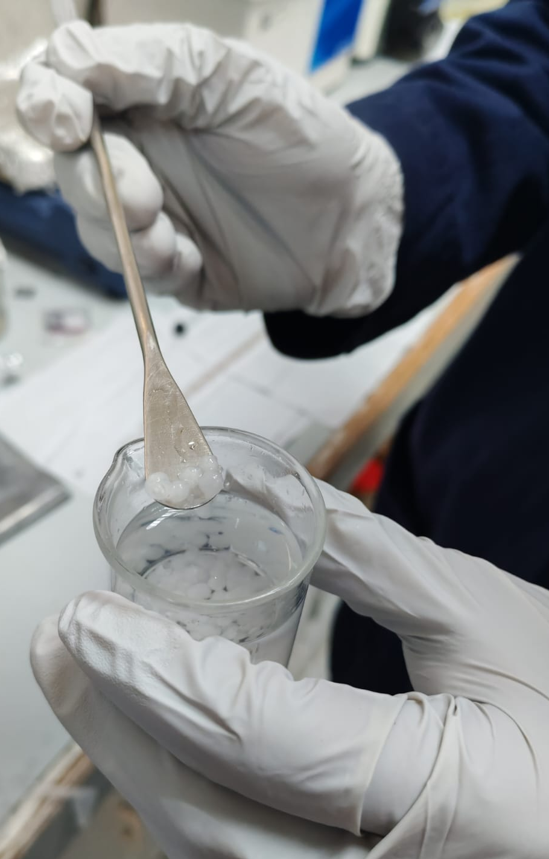
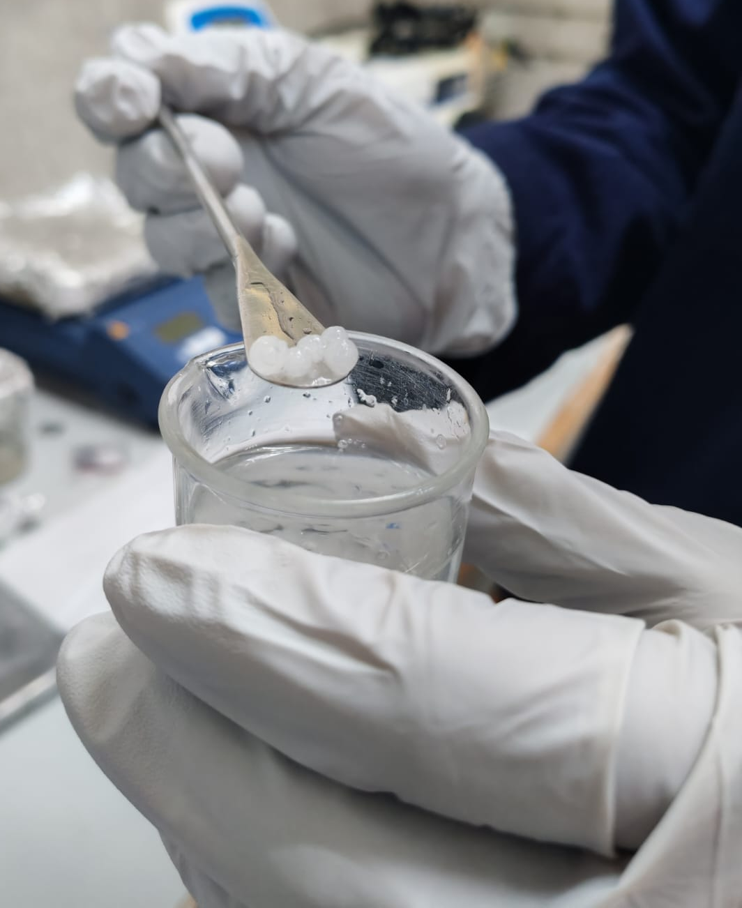
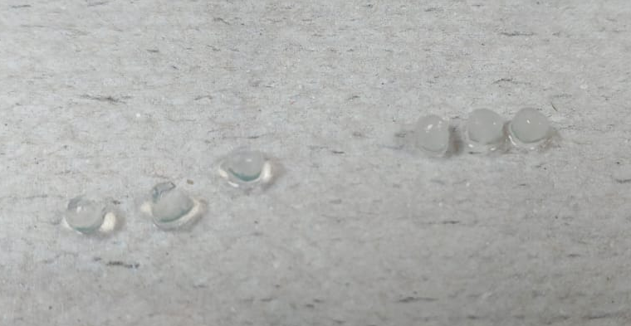
Alginate beads with encapsulated pyrrole compounds

Slide 23



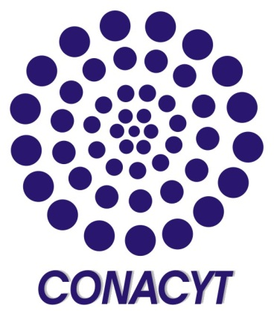
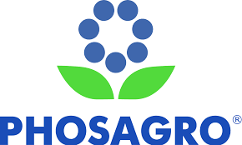
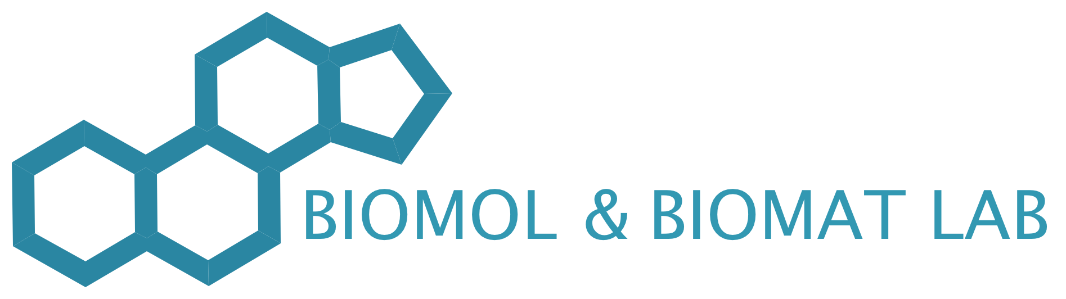



Acknowledgements
All the members of the research group and colleagues
https://sites.google.com/view/biomol-biomat-lab/home
mfernandez@cinvestav.mx
marietafernandezh@gmail.com
@mafernan9

Slide 24

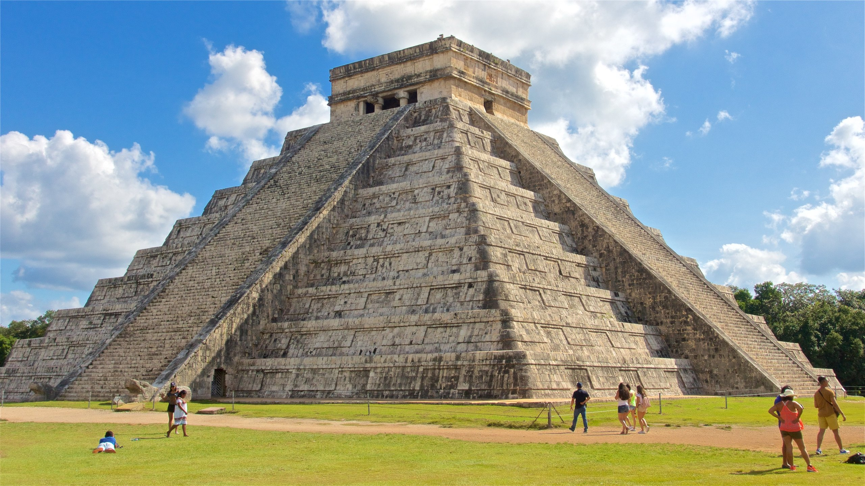
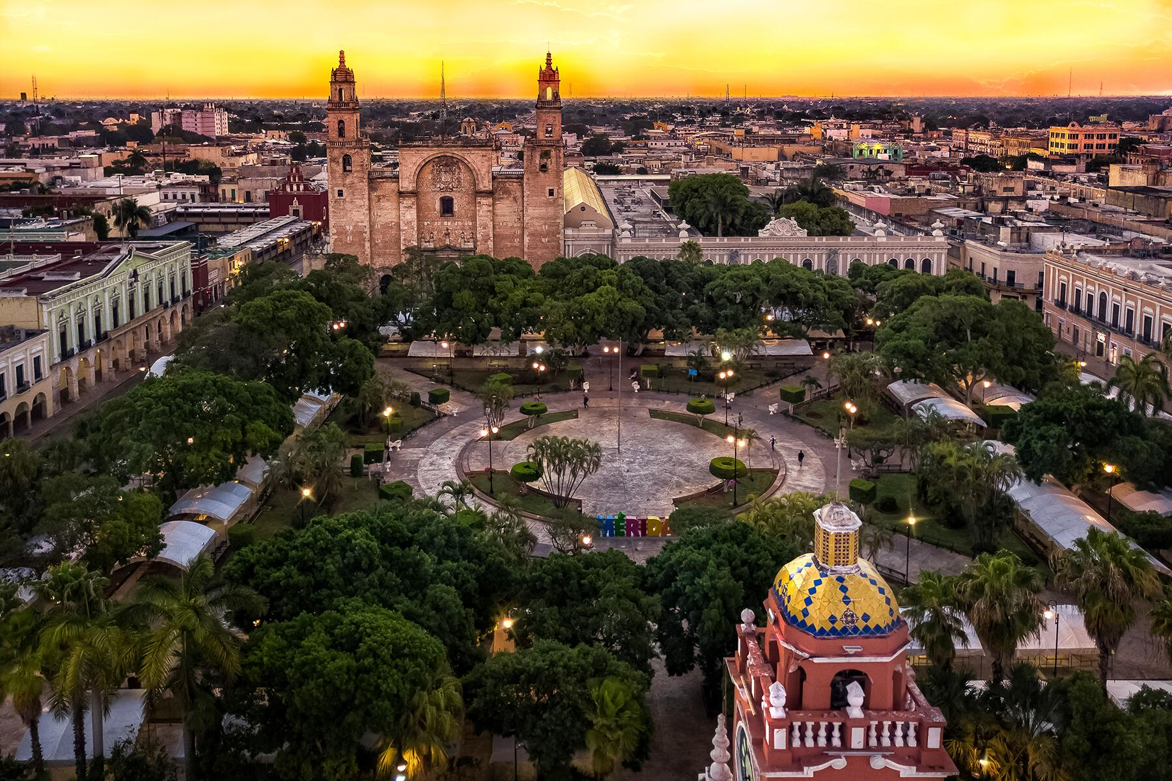

Visit Yucatan, Mexico

Slide 25
Thank you!

