Slide 1
Carbon sequestration and soil governance in Europe
Rosa M Poch
Professor (Full), Department of Environment and Soil Sciences, Universitat de Lleida, Spain
Protecting the planet's soils from degradation and depletion. International experience maintaining soil fertility and health
Russian State Agrarian University - Timiryazev Moscow Agricultural Academy - FAOLOR

Slide 2
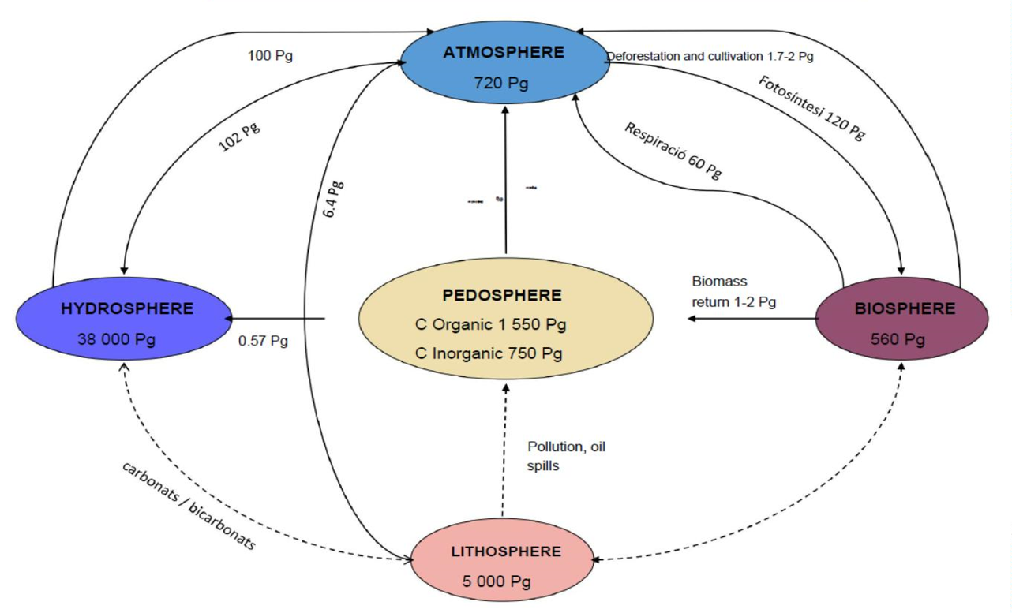
Reservoirs and flows of C in the earth (Lal, 2001)

Slide 4
Rice experiment: Concentrations of HM in the soil and irrigation water
Can agricultural management that increases soil
organic matter become a mitigation or adaptation
strategy to climate change?
If so, which management tools (political, economic, financial) are the most appropriate to promote this?
What tools are currently available to act?

Slide 7
4p1000 Initiative
proposed by the French
government (COP21 Paris, 2015)
... is it possible?

Slide 8
Carbon emissions and estimated global potentials for carbon sequestration in soils and vegetation (UNEP/GRID-Geneva)

Slide 9
http://www.fao.org/global-soil-partnership/pillars-action/4-information-and-
data-new/global-soil-organic-carbon-gsoc-map/en/

Slide 10
SOC sequestration potential map

Slide 11
Recarbonizing global soils: A technical manual of best management practices ( FAO, ITPS 2021)
11 Hot spots: droughts, forests, wetlands, mangroves, black soils, permafrost
73 practices: cropping systems, pastures,
forest management and silviculture,
wetland ecosystems, urban land management, alternative agricultural systems and integrated systems.81 case studies: from all regions (short, mèdium and long term).
https://www.fao.org/documents/card/en/c/cb6386en

Slide 12
Verification of the Organic Carbon of the soil ? Approaches:
• Direct measures in the medium-long
term (4-8 years): way to quantify C
Credits
• Modeling (Century, RothC,...)
• Subsidize management systems
• Determine maximum C contents based
on other parameters (e.g. saturation
potential)

Slide 13
Cabbage experiment: Results
RECSOIL‘toolkit’

Slide 14
Conclusions
10. Calls on the Commission to design an EU-wide common legal
framework, with full respect for the subsidiarity principle, for the protection and sustainable use of soil, addressing all major soil threats (…)
18. Stresses that soil protection, its circular and sustainable use and its restoration need to be integrated into and should be made consistent across all relevant EU sectoral policies (…)
65. Understands the importance of cooperation at all levels to effectively address all soil threats; calls on the Member States, therefore, to lead by example and to consider initiating a soil convention within the UN.
For a EU Soil Strategy:

Slide 15
The European Green deal
Transform the EU into an
equitable, prosperous
society, with a modern
economy and efficient use
of Natural Resources.
Reduction of greenhouse
gas emissions (GHG) in
2030.
Transformation of
agriculture and rural areas.
Participatory systems

Slide 16
Farm to fork
Reduce 50% the use of agrochemicals
Reduce nutrient loss by 50% to preserve soil fertility, reducing fertilizer by 20%
Reduce the use of antimicrobials for farm animals and aquaculture by 50%
Increase the percentage of organic
crops in the EU by 25%

Slide 18
There is still a lack of general consensus on the fact that soil is an issue that requires international policy and legislative support.
The goal of land degradation neutrality in SDG 15.3 has established a global policy starting point, but still lacks strict definitions to implement as specific actions.
Various global institutions and initiatives dealing with different soil ecosystem services in a sectoral manner, which should be harmonised.
The Global Soil Partnership could become the leading UN body to establish global soil protection policies that are necessary to face the next challenges, such as mass migrations or the consequences of climate change.
In Europe, soils are back on the agenda, but we should not lose sight of their function as the main factor in food production, in the face of conservationist approaches.
We should shift the focus, from considering soil simply as a provider of services to humanity, to treating it as an object that requires care, for the sake of future generations.

Slide 19
Thank you!

